Slide 1
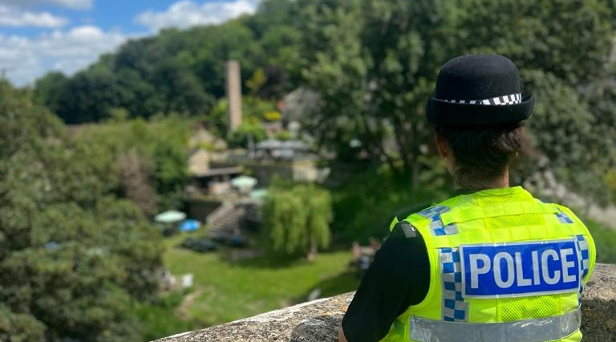
Melksham & Bradford on Avon Neighbourhood Policing Team
Rural Report November 2023

Slide 2

Meet your team:
Melksham
Bradford on Avon

Slide 3

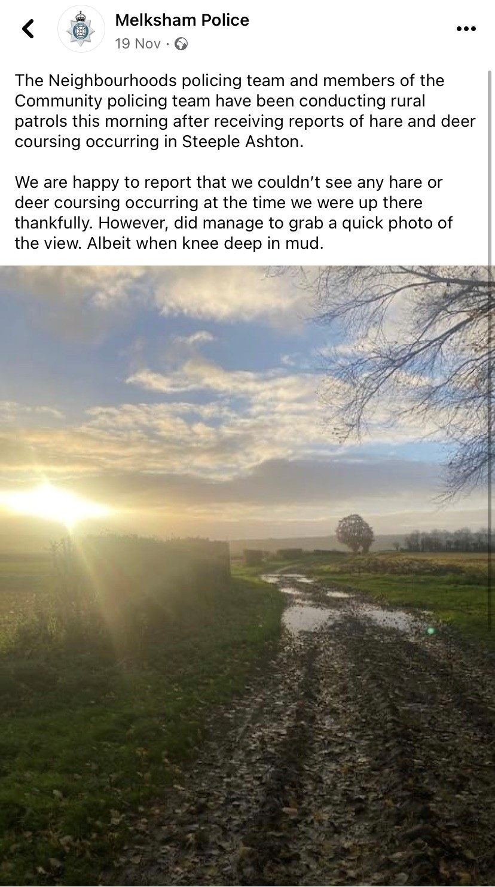
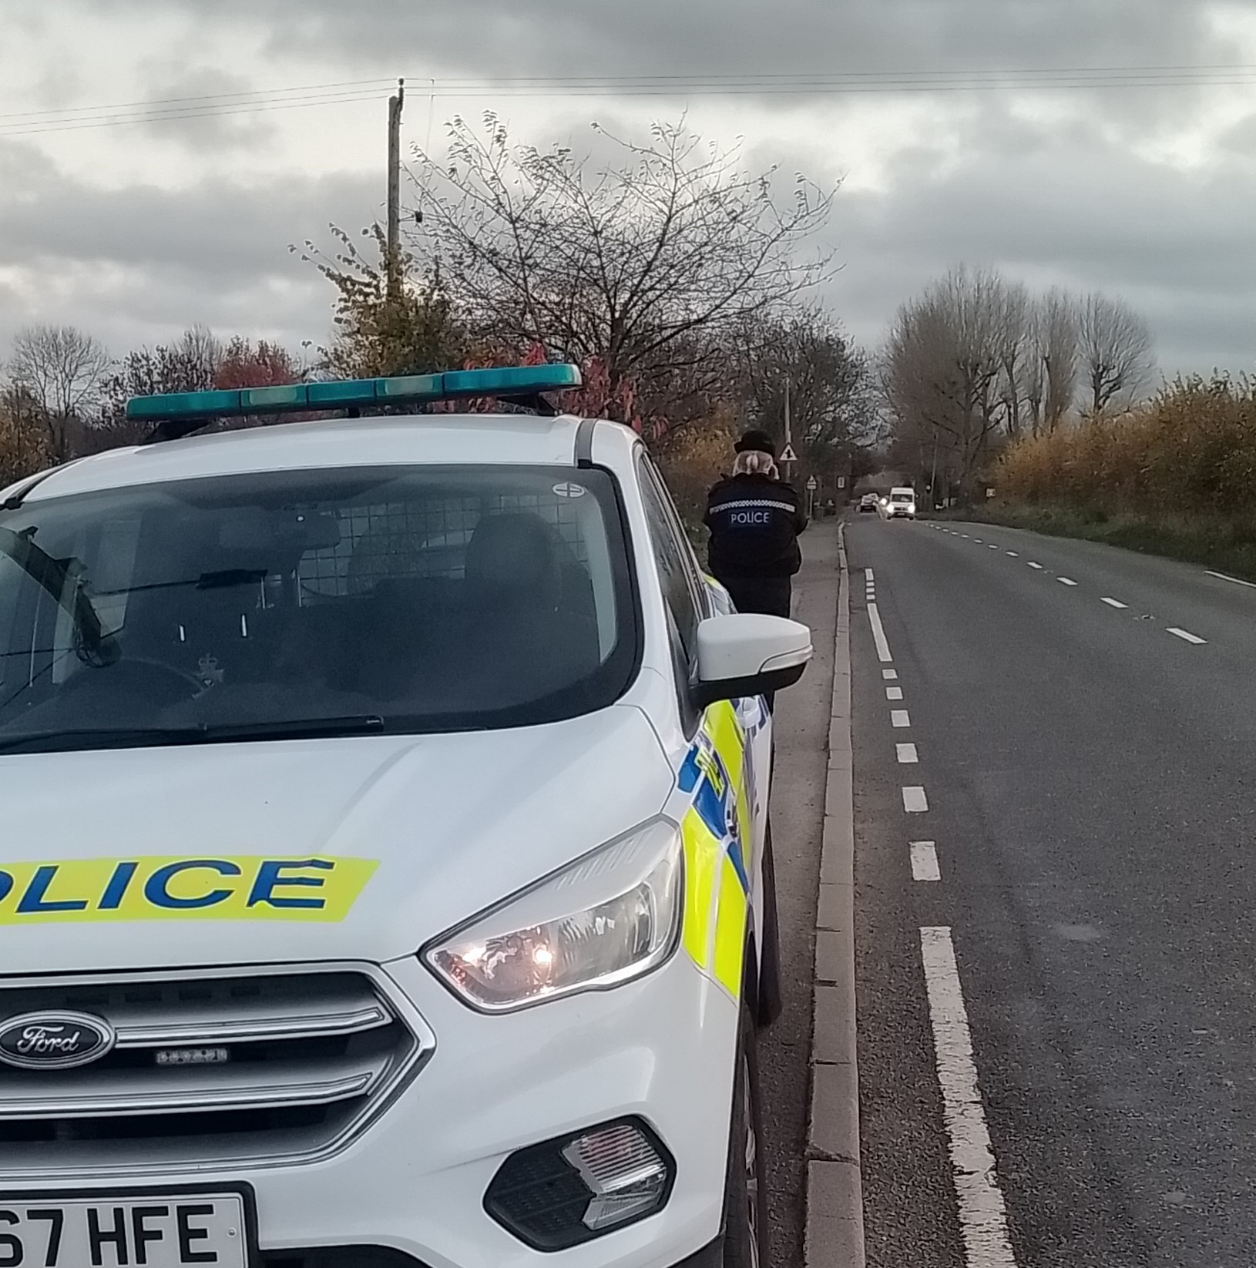
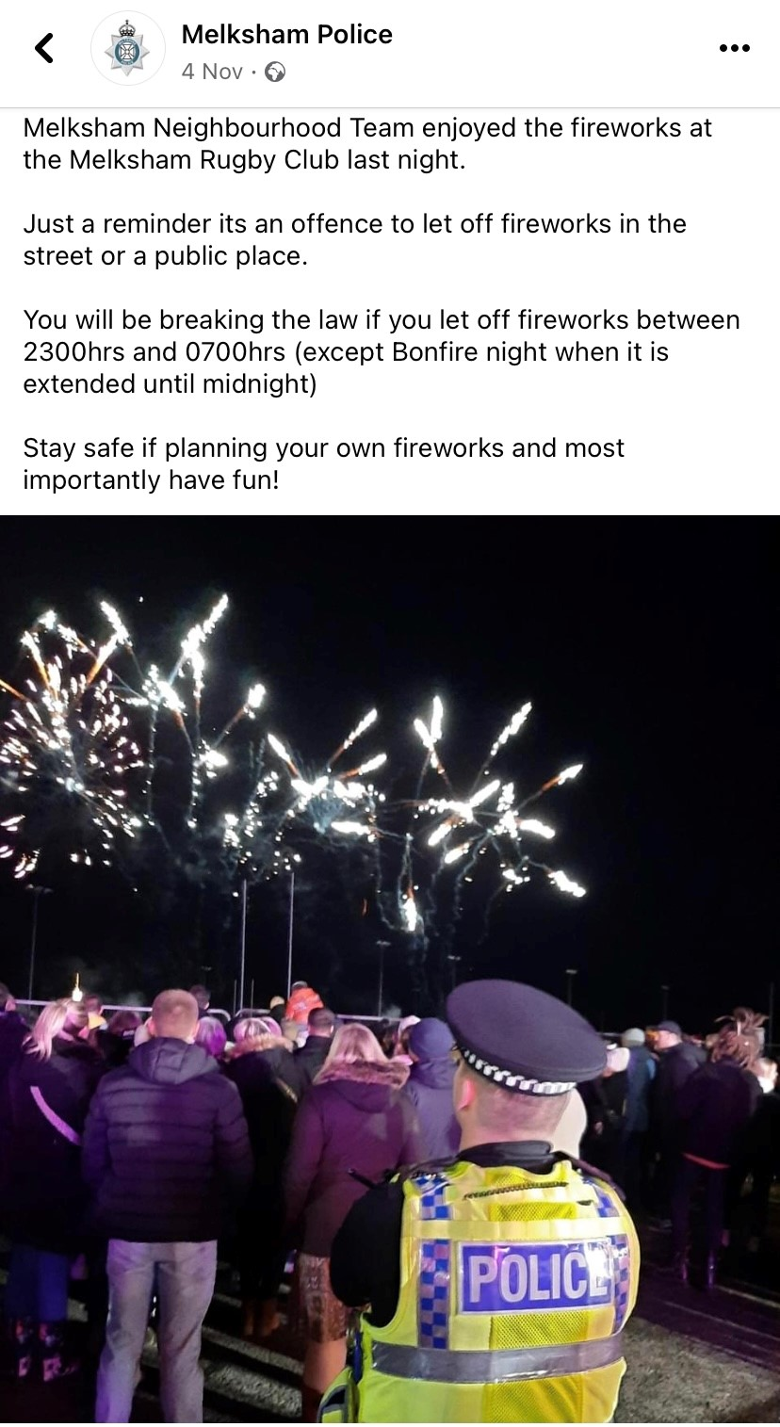
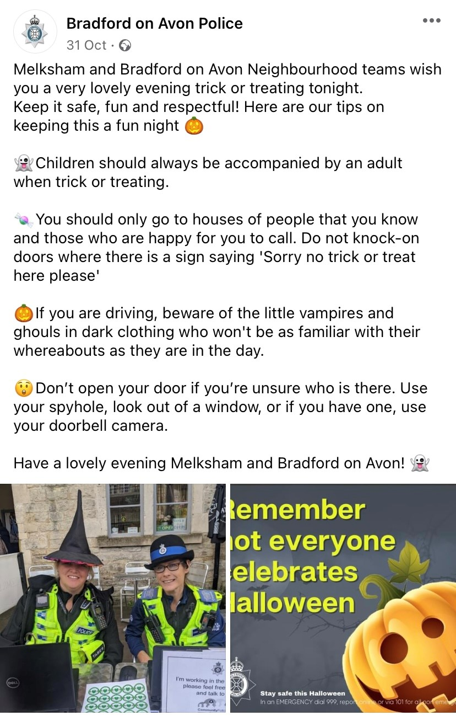

Where have we been and what have we been up to?
NHW meetings to discuss how to increase membership in rural communities
Speed watch in Bradford on Avon
Hare/ Deer coursing patrols in Steeple Ashton
Firework patrols
We carried out drop in surgeries in rural points to promote safe Halloween
Memorial Parades in our towns and villages

Slide 4
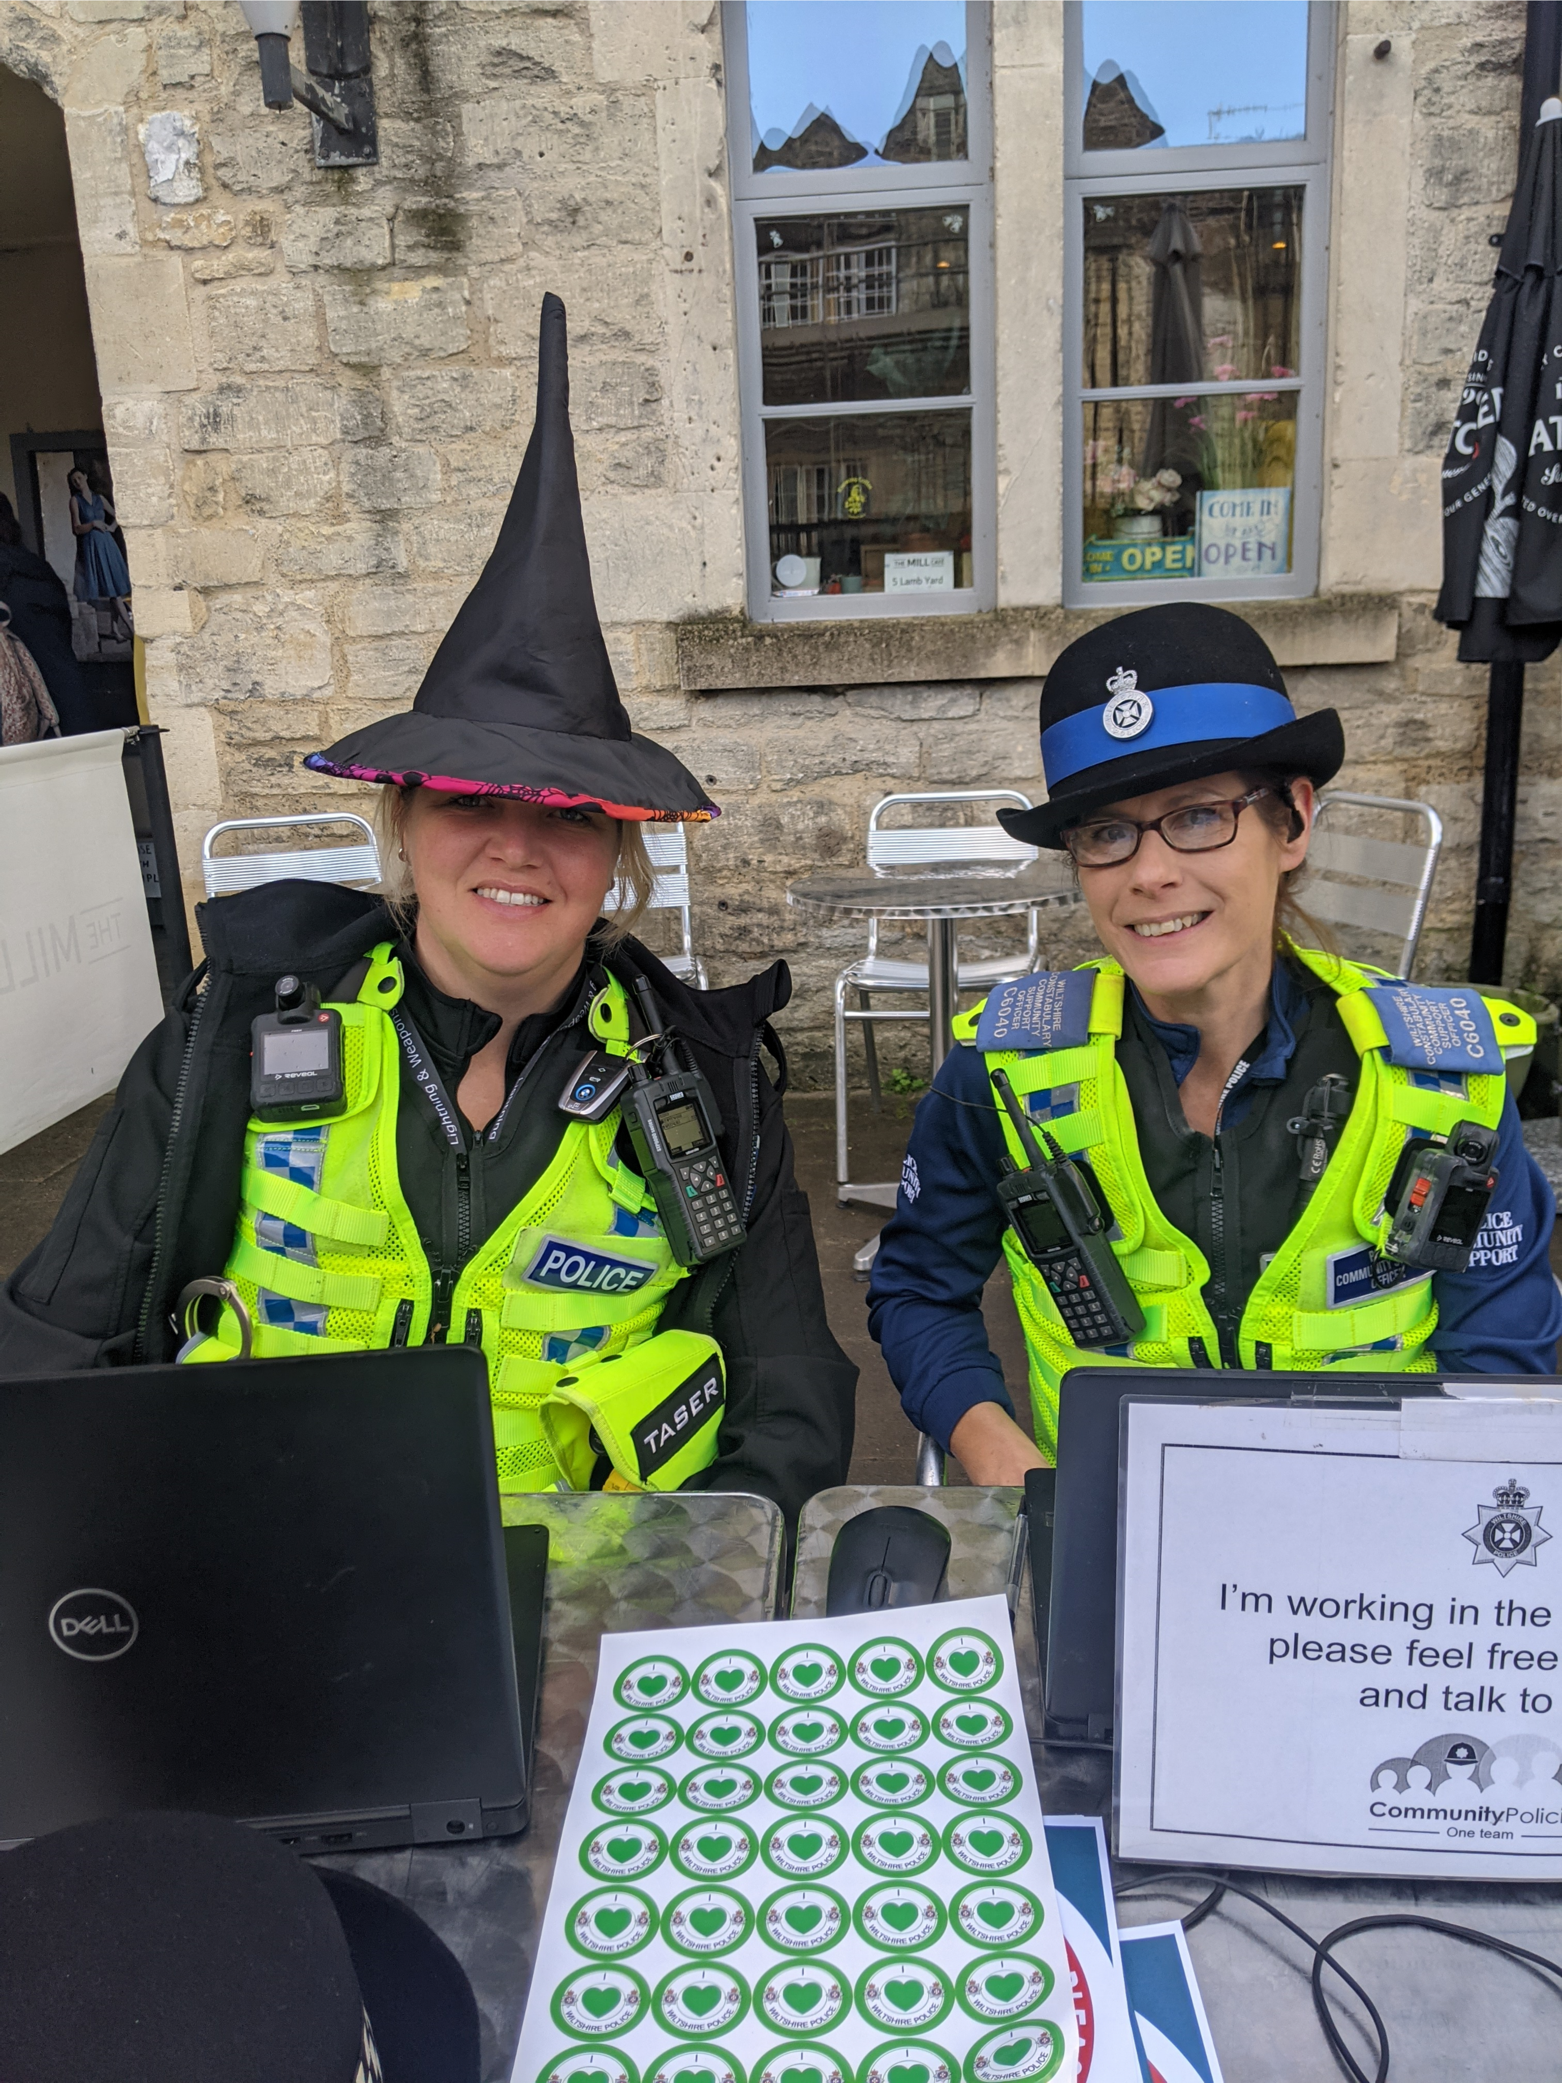
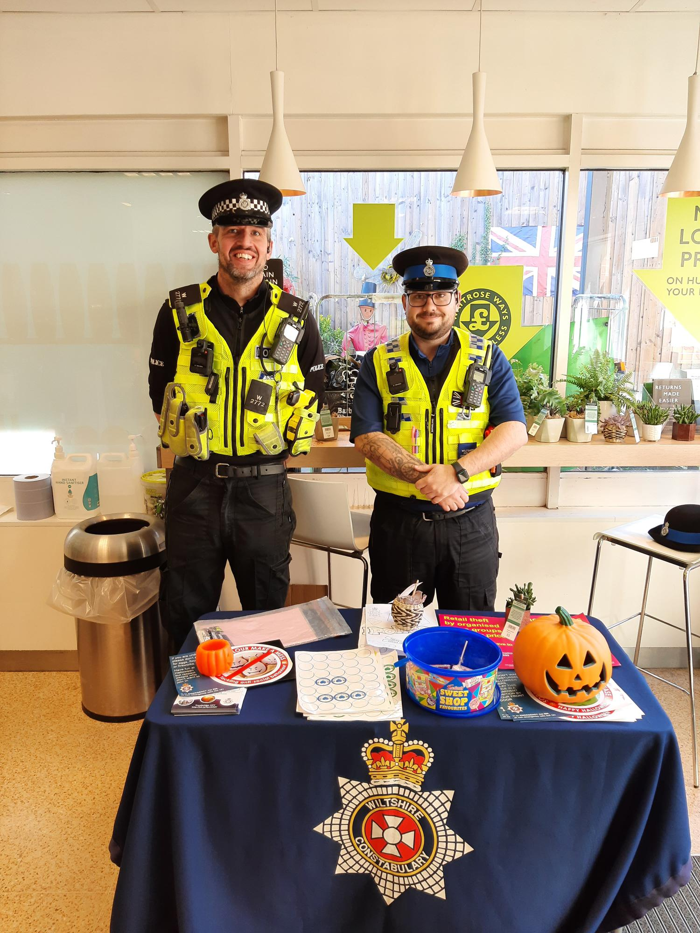
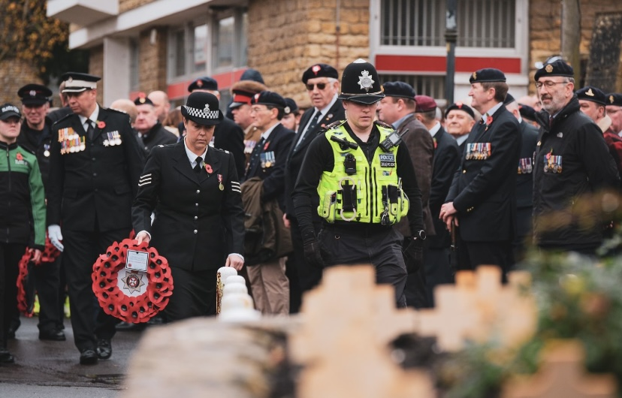
Key Incidents and Crimes in Your Area:
BURGLARY:
*1 in Melksham Without, shed break
*1 in Sells Green, Unknown suspect has gained entry to a unit that IP rents. All items from inside the unit have been stolen, including a motorbike, generator and electrical goods.
*1 shed break- Broughton Gifford
THEFT:
*1 Handbag theft, Steeple Ashton- bag left by side of vehicle, missing when owner returned.
RTCs:
*Semington- x1 minor injury, X1 fatal RTC
*Seend- x1 careless driving investigation
*Atworth- x1 minor injury RTC

Slide 5
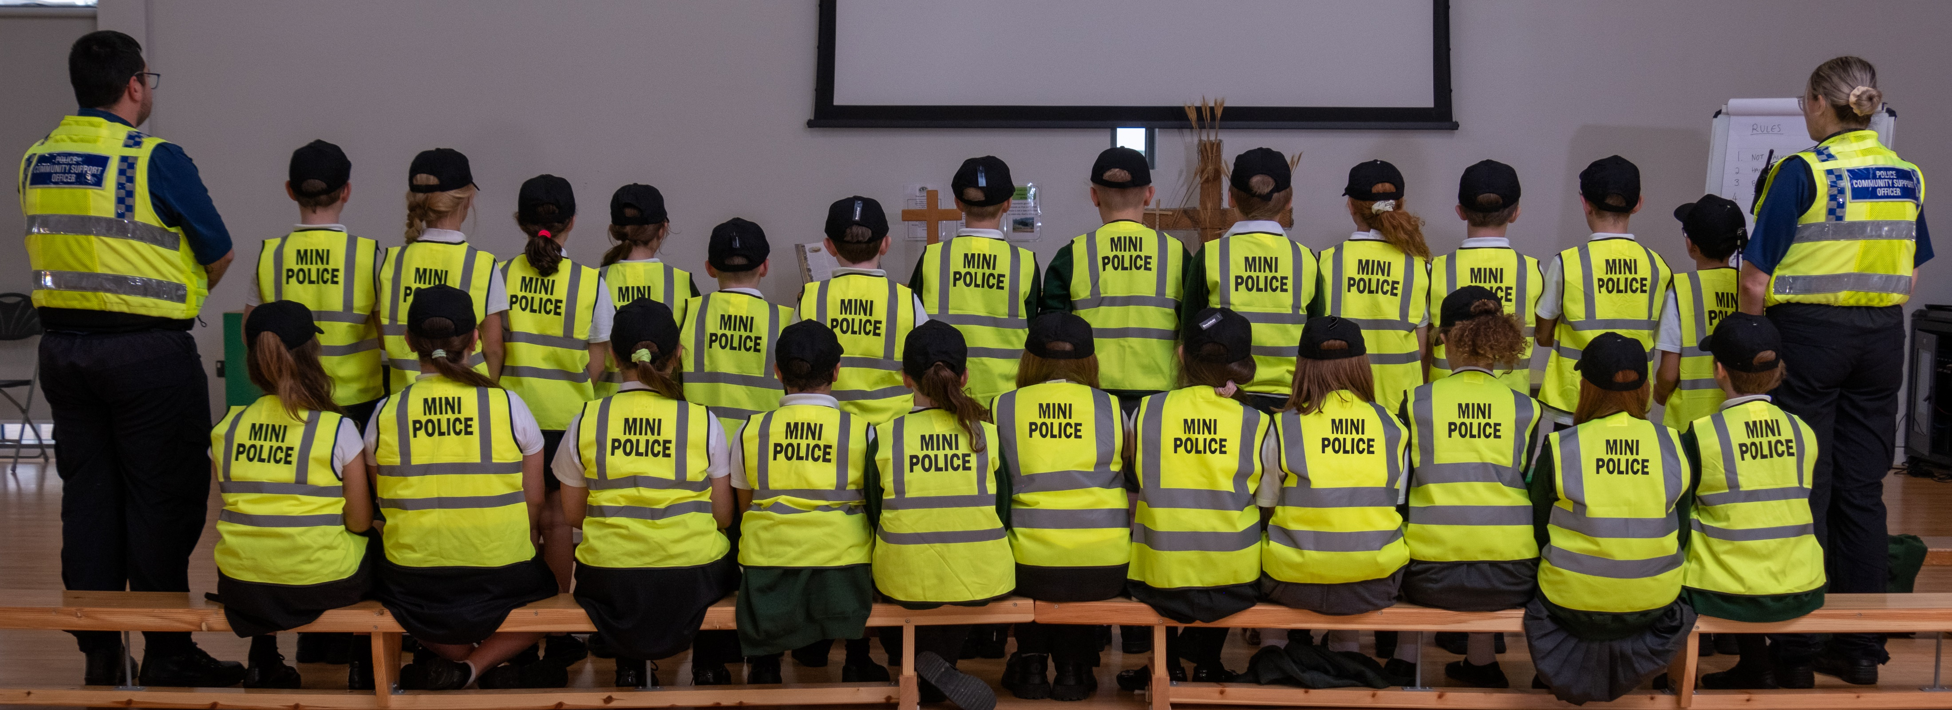
NEWS:
Upcoming dates:
18/12/23- Urban area proactive day-high visibility patrols, public engagement and shoplifting patrols.
Safer Nights Patrols
19/12/23- Rural area proactive day- high visibility patrols, public engagement and speed checks
23/12/23- Melksham and Bradford on Avon- Safe Nights Patrol
If you have any events you would like us to attend, please contact us! We are happy to attend when we are free and able to do so- we can bring leaflets, advice and updates to events in your area. Just contact the officer aligned to your area, the PCSO team or the team as whole at TrowbridgeAreaCPT@wiltshire.police.uk

Slide 6

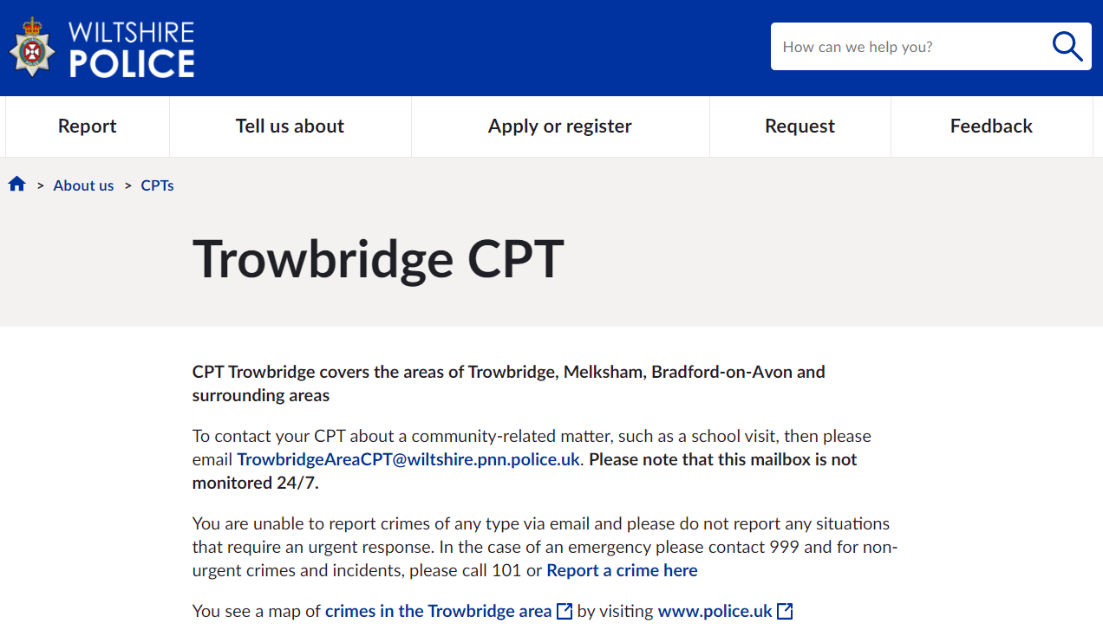
Get Involved
Keep up to date with the latest news and alerts in your area by signing up to our Community Messaging service – www.wiltsmessaging.co.uk
Follow your CPT on social media
Trowbridge Police Facebook
Trowbridge Police Twitter
Melksham Police Facebook
Bradford on Avon Facebook
Find out more information on your CPT area at: www.wiltshire.police.uk and here www.wiltshire-pcc.gov.uk

