Slide 1
Melksham & Bradford on Avon Neighbourhood Policing Team
Rural Report Oct 2023

Slide 2
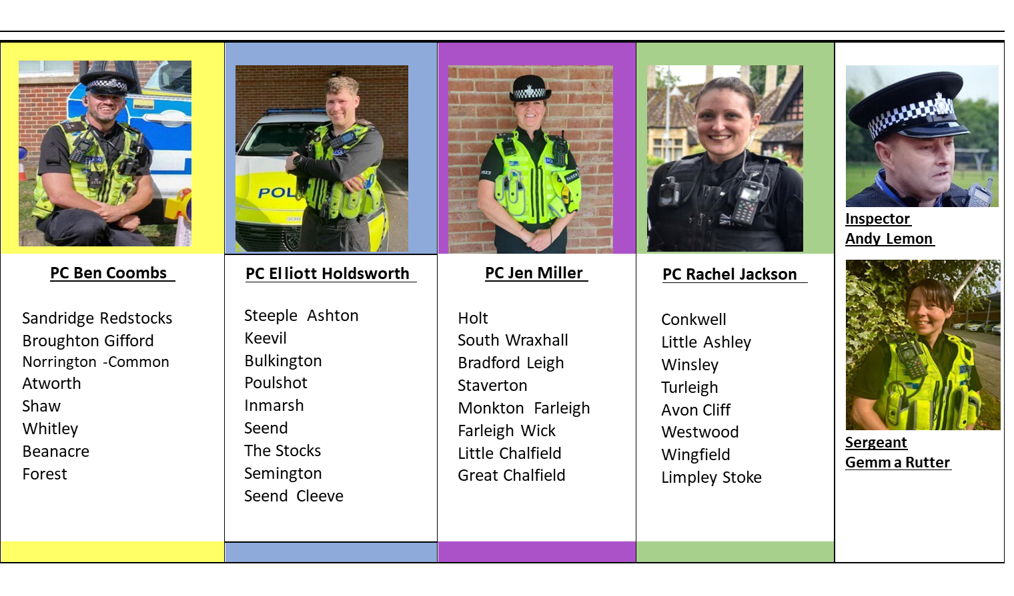
Meet your team:
Melksham
Bradford on Avon

Slide 3
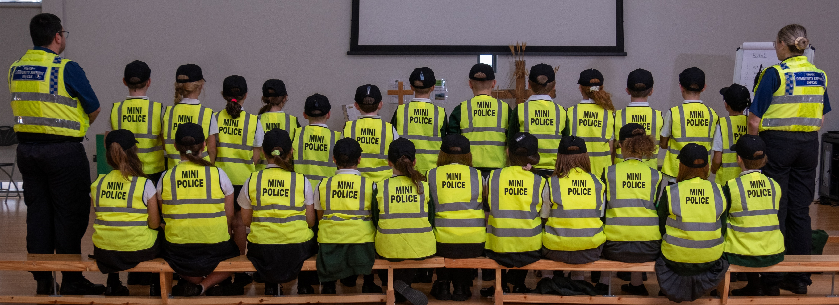
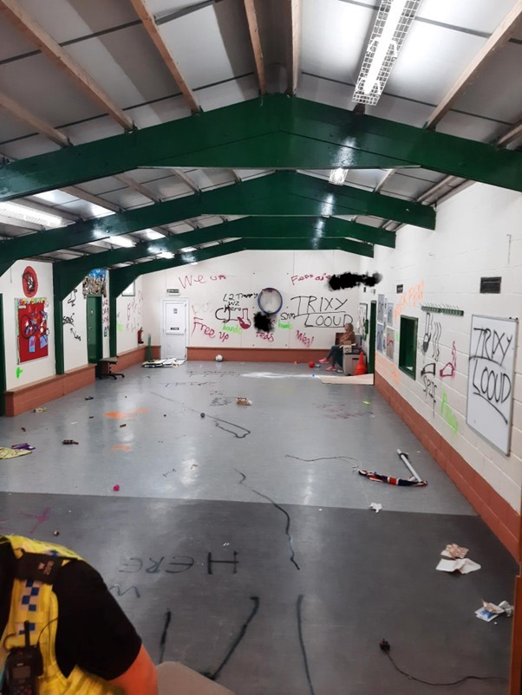
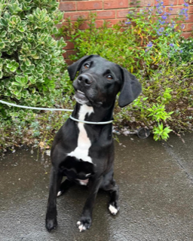
Where have we been and what have we been up to?
School Visits at our local schools including Mini Police
Force Road Safety Campaign with another event planned in November
We have carried out a number of engagements to promote Community Messaging
Arrest and investigation of 3 youths connected to arson, criminal damage and theft offences
A further drug warrant completed in Melksham with co-accused address in Bristol for drugs- with the help of PD RAIN
Local business engagement for Business Safety Awareness week

Slide 4
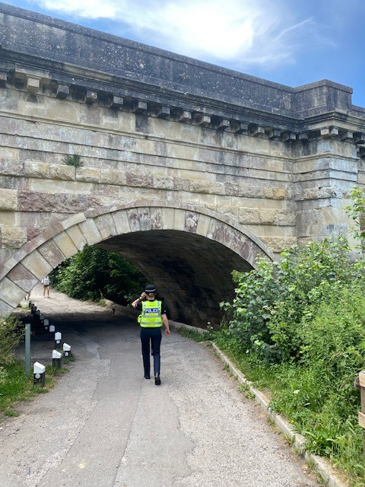
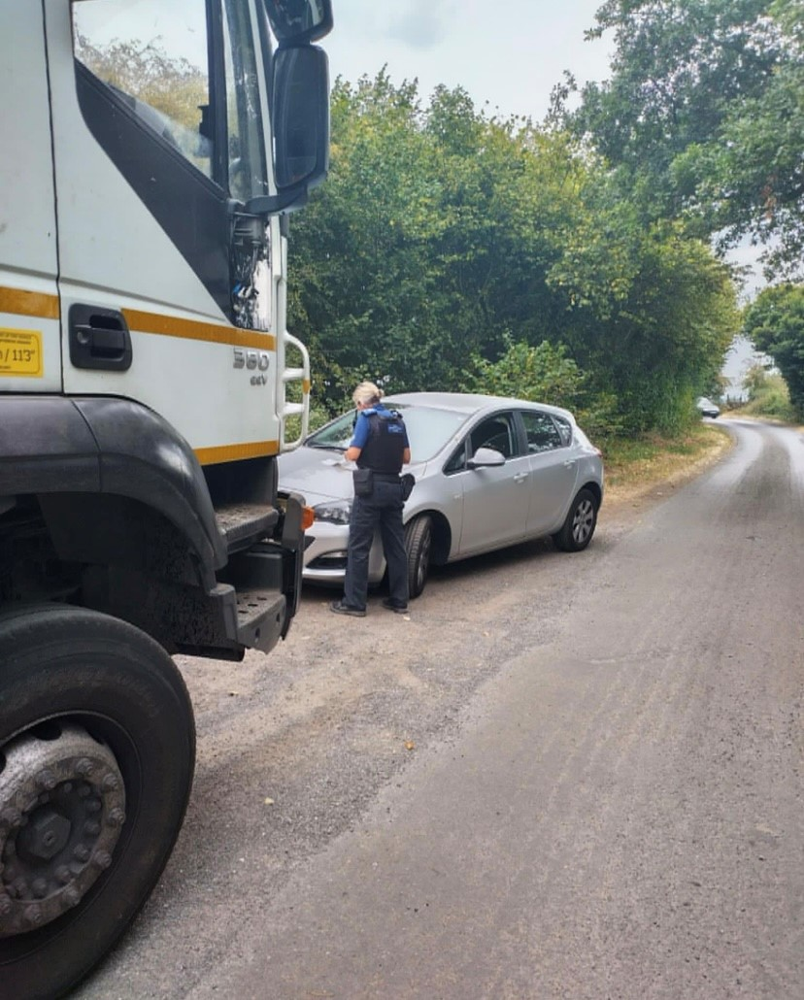
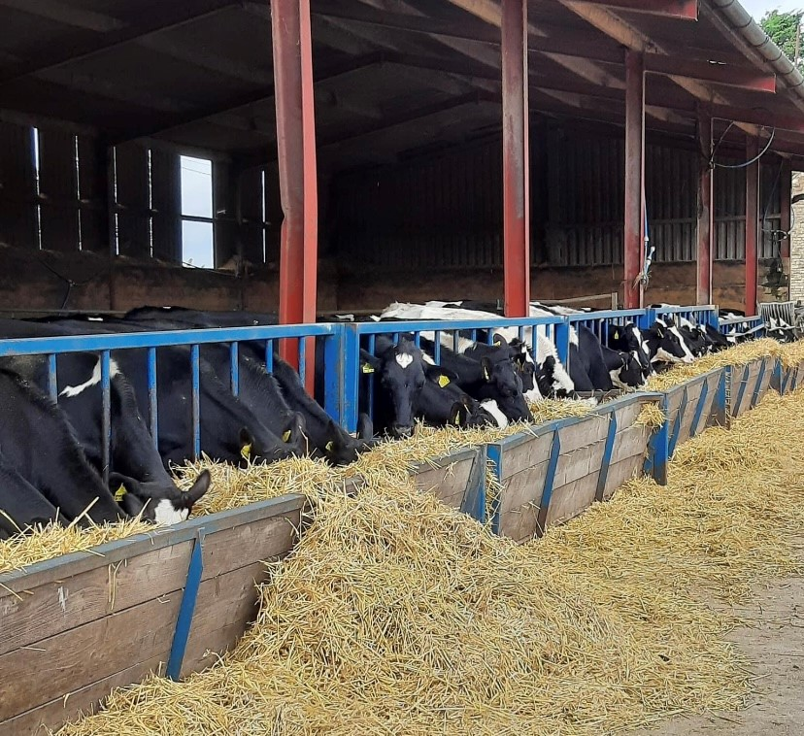
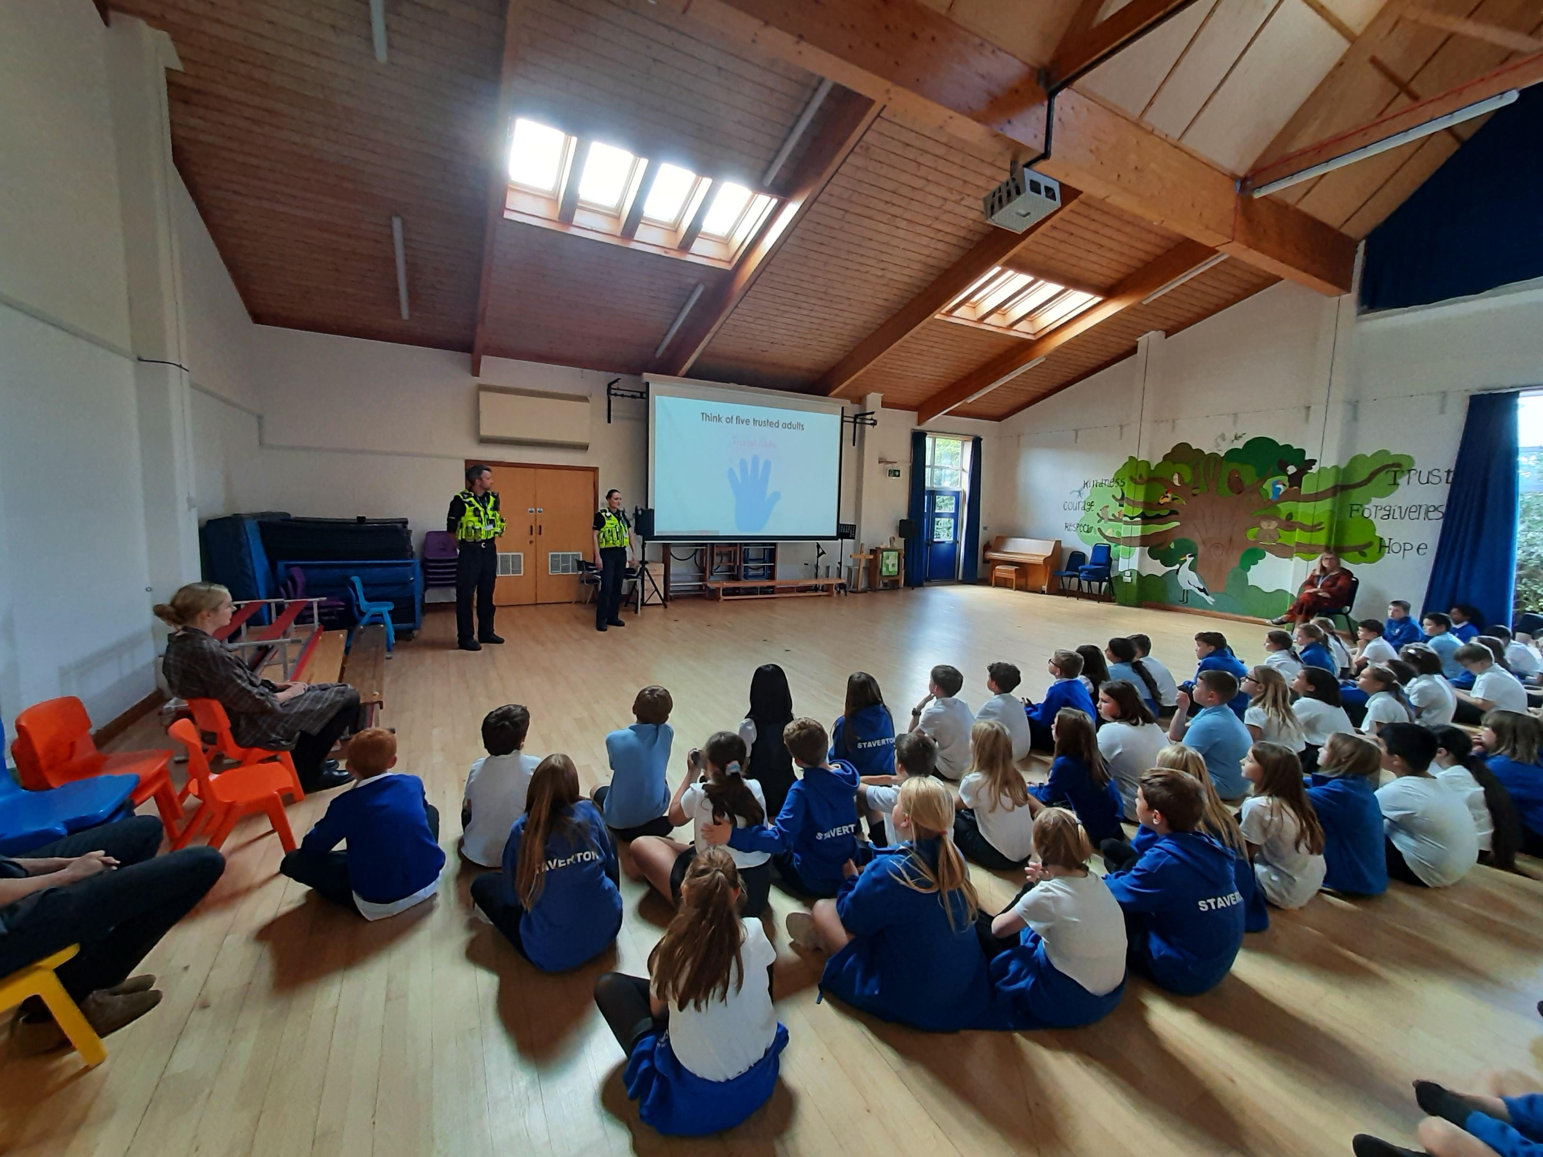
Key Incidents and Crimes in Your Area:
08/10/23- TURLEIGH- Hedge damaged, potentially ongoing neighbour dispute
09/10/23- GREAT CHALFIELD- Axe thrown onto roof of greenhouse causing damage
10/10/23- LIMPLEY STOKE- Lorry damaged bridge FTS RTC
12/10/23- ATWORTH- Damage to wall at the village hall
13/10/23- HOLT- FTS RTC non injury
14/10/23- MONKTON COMBE- Theft of bronze garden fountain
15/10/23- SEMINGTON- Attempt vehicle break in, rubber seal damaged
18/10/23- LOWER WESTWOOD- Burglary, suspect identified and investigation continues
19/10/23- STAVERTON- Vehicle stolen and crashed; driver arrested
23/10/23- FARLEIGH RISE- FTS RTC, wing mirror damaged
26/10/23- KEEVIL- Stihl leaf blower stolen from flatbed truck
27/10/23- SEEND- Non injury RTC; driver arrested
27/10/23- BOWERHILL- Non dwelling burglary- x3 suspects pending arrest

Slide 5
NEWS:
Upcoming dates:
Safer night patrols- the team will be out and about in Melksham and Bradford on Avon sharing advice to those on a night out on how to get home safe and look out for each other as Christmas party season is heading our way. We will also be attending the rural pubs to make sure they have literature displayed for safety campaigns such as Ask for Angela. These patrols will be on the 23/11/23, 16/12/23 and the 19/12/23
Firework nights-
03/11/23- PC COMBS and PCSO CULLIFORD will be patrolling at the Melksham fireworks events.
04/11/23 - PCSO Laura WALLACE will be accompanied by PCSO HOSKEN on the patrolling Broughton Gifford fireworks display.
05/11/23 - PCSO WALLACE and PCSO THOMAS (Trowbridge) will be at the Bradford on Avon fireworks
Event.
If you have any events you would like us to attend, please contact us! We are happy to attend when we are free and able to do so- we can bring leaflets, advice and updates to events in your area. Just contact the officer aligned to your area, the PCSO team or the team as whole at TrowbridgeAreaCPT@wiltshire.police.uk

Slide 6
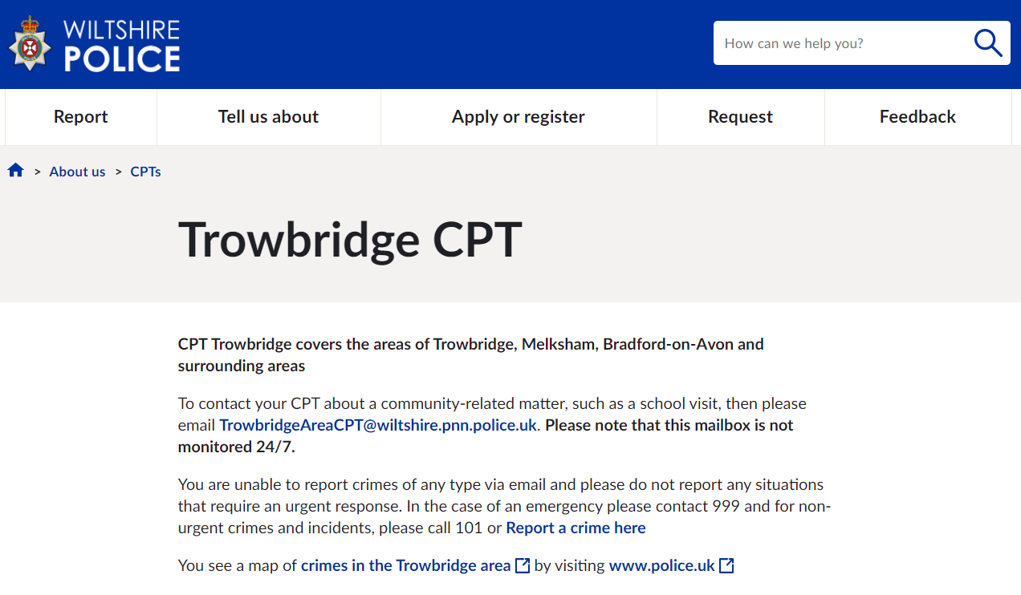
Get Involved
Keep up to date with the latest news and alerts in your area by signing up to our Community Messaging service – www.wiltsmessaging.co.uk
Follow your CPT on social media
Trowbridge Police Facebook
Trowbridge Police Twitter
Melksham Police Facebook
Bradford on Avon Facebook
Find out more information on your CPT area at: www.wiltshire.police.uk and here www.wiltshire-pcc.gov.uk

