Slide 1
Steeple Ashton – Annual Report
May 2022 – April 2023

Slide 2
The Team
Inspector
Andy Lemon
Sergeant
James Twyford
Constables
Jen Miller
Ben Coombs
Community Support Officers
Vic Rolph
Mel Culliford
Luke Hosken
From 8th May 2023 onwards, the Sergeant’s position is being taken over by Sergeant Gemma Rutter.
She brings with her a wealth of experience, coming into the role having previously worked in Response, Neighbourhoods and CID as both a Constable and a Sergeant.

Slide 3
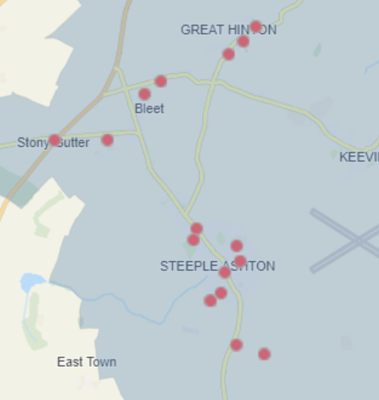
The Last 12 Months
The Parishes of Steeple Ashton and Great Hinton are incredibly fortunate communities, who benefit from exceptionally low crime rates.
Against a backdrop of 21,000 incidents over the Trowbridge, Melksham and Bradford on Avon areas in the last 12 months; a mere two incidents were reported in Great Hinton and 10 in Steeple Ashton, of which only two were recordable Crimes. That equates to 0.04% of our total demand. This low level of crime isn’t matched across any of our other Parishes.
There were a small selection of Road Traffic Collisions at junctions, which add slightly to the numbers; but there are no identified hotspots for these collisions.

Slide 4
Crime and Incident Types
Three offences related to Domestic Incidents.
Two were Road Traffic collisions and a third was a Road Rage incident.
There was one instance of Violence against the Person, which was of a low level and between people known to each other.
There was one Burglary, which was investigated as part of a larger series which affected Melksham Rural South. This is our most noteworthy recent success, as we’ve successfully manage to see Daniel STACEY, aged 34, of Bradford on Avon Remanded to Prison for 10 offences.
The last Crime report to mention, was an instance of Criminal Damage to a gate.

Slide 5
Community Engagement
Community Engagement is a staple of the Neighbourhood Team. Our three PCSO’s split their time across the Melksham Town and Rural areas, conducting drop-in sessions at numerous places throughout the month.
We will conduct ad-hoc drop-in’s at the Steeple Ashton Community Shop, to listen to local worries and provide a visible presence. We will also continue to visit the local Community Speedwatch Schemes, who maintain a regular presence.
This is however at an inevitably reduced level compared to years gone by. Posts have been lost; demand has increased and the amount of administrative work behind every case has increased by around 20% over the last year, as the necessity for accountability increases.
We partake in a number of ‘Weeks of Action’, which largely exist to bring certain areas of focus to the front of peoples’ minds. Most relevant to Steeple Ashton, is “Project Zero”, which is part of a National campaign to reduce
the number of road deaths. It targets the Fatal Five – mobile phone use, drink and drug driving,
Careless driving and failing to wear seatbelts. This runs weekly, is headed up by our Roads
Policing Colleagues and targets the Trowbridge area 5-weekly.

Slide 6
Reporting
If there’s one thing anyone learns from working in Neighbourhood Policing, is that underreporting of incidents is a fairly consistent theme. People will say “What’s the point?” or “It didn’t seem worth reporting”, but every report we get helps to paint a picture.
Underreporting also creates a bit of a disconnect between perception and reality (the same could also be said of those who take to Social Media and write exaggerated accounts, but that’s a different issue). This in turn, makes it harder to prioritise work, identify suspects and conduct quality investigations.
If I were to make one plea, it would be to please report incidents and do it directly to us, as factually as possible. Even if that one report in isolation can’t be progressed; it still helps to inform our Priorities and occasionally, it helps to solve a series of offending. Our recent Burglary series was solved by a concerned member of the public, who saw our
hapless offender, sleeping at the wheel of a stolen car. They wouldn’t have known that when they called in
a concern for his welfare, but their observation helped us to recover a vast amount of stolen property
and put a prolific offender in Prison.

Slide 7
Further Information
You can find out more about Policing in your area by following any of the links below:
Local Crime Data: https://www.police.uk/pu/your-area/wiltshire-police/
Police and Crime Commissioner’s Website: https://www.wiltshire-pcc.gov.uk/
HMICFRS Website: https://www.justiceinspectorates.gov.uk/hmicfrs/police-forces/wiltshire/
You can also follow the Local Team on Facebook, either by searching for “Melksham Police”, or visiting www.facebook.com/MelkshamPolice
Additionally, we offer more bespoke updates, filterable by personal interests, using our “Community Messaging”
this can be found at www.wiltsmessaging.co.uk

