Slide 1
St. Mary’s School Building Management Committee (SBMC)
Report for year-ending 31st March 2023

Slide 2
St. Mary’s School Building Management Committee
A brief history
The school building has been held in a Trust set up by the Long family in 1846, may be even earlier, so, approaching 180 years !
Up until 2004, the building was used for many many decades as the village primary school, and was run by the then County Council
When the school was closed in 2004, the building was handed back by the council to the Trustees (the parish vicar and the churchwardens)
The trust deed stipulates that building should be used for the benefit of the village, and should be home to at least one organisation of educational benefit
The Trustees have appointed the School Building Management Committee (SBMC) to run, manage and maintain the school building for the benefit of the tenants and the village. The SBMC commenced work at the end of 2004

Slide 3
Who is on the SBMC currently ?
Committee (volunteers)
Richard Boardman - PCC rep.
Malcolm Bond - Chairman
Marion Pearce - SA W.I. rep.
Lydia Peters - Friends of SA rep.
Jonathan Tapper - SA PC rep.
Tenants’ representatives
Beryl Francis - Guild
Maureen Hodge - STASH
Val Laverick - Guild
Administrator (volunteer)
Lynda Beaven
Trustees
The vicar of Steeple Ashton parish
Michael Moore - Churchwarden

Slide 4
SBMC - accounts for 2022/23 (unaudited)
 | ST. MARY'S SCHOOL BUILDING MANAGEMENT COMMITTEE
 | Financial year 1st April 2022 to 31st March 2023
 | Income & Expenditure for 2022/23 |  |  | Balance Sheet for 2022/23
 |  |  |  |  | £
 | INCOME | £ |  | Current account as at 31/03/22 | 6,796.47
 | · Income – net service charge payments from tenants | 7577.31 |  | Deposit account as at 31/03/22 | 17,045.53
 | · Wayleaves | 1.00 |  | TOTAL (all cash in hand at bank) as at 31/03/22 | 23,842.00
 | · Interest on deposit account | 32.32 |  |  | £
 | · TOTAL INCOME | 7610.63 |  | Current account as at 31/03/23 | 10477.15
 |  |  |  | Deposit account as at 31/03/23 | 17077.85
 | EXPENDITURE | £ |  | TOTAL (all cash in hand at bank) as at 31/03/23 | 27555.00
 | · Insurance | 1973.09 |  |  | £
 | · Maintenance & repairs | 575.00 |  | Increase in current account funds: | 3680.68
 | · Water & sewage | 329.01 |  | Increase in deposit account funds: | 32.32
 | · Fire system | 515.16 |  |  | £
 | · Fuel oil | 446.62 |  | Total additional funds in hand: | 3713.00
 | · Window cleaning | 0.00
 | · Administration | 58.75
 | · Legal & property services | 0.00
 | · TOTAL EXPENDITURE | 3897.63
 |  | £
 | Net income/(deficit) | 3713.00

Slide 5
SBMC – key highlights from 2020-2023 (1)
COVID PANDEMIC
The pandemic has caused an unprecedented change in how the SBMC has conducted its business, with no face-to-face meetings since early 2020. Emails have proved OK, especially as there has not been a great deal of significant activity
TENANTS’ SERVICE CHARGES
In order to give financial support during the pandemic, SBMC had provided STASH and the Guild with significant service charge reductions during the 2020-2021 timeframe, amounting to a total of £8600
In addition to the above, a 25% reduction in tenants’ service charges was implemented from 1st April 2022
Steeple Ashton Parish Council gave notice to quit their office wef 31st March 2022. The room is now being jointly used by STASH and SBMC

Slide 6
SBMC – key highlights from 2020-2023 (2)
MAINTENANCE
Significant maintenance and repairs work over the past 3 years:
Painting & decorating of 1st-floor rear room (Guild)
Boundary fencing, left-hand (south) side – 50/50 shared costs with neighbour
Boiler servicing, oil fuel line repairs, hot water heater and CH repairs
Shop LED lights and outside lighting
Repairs to two first-floor (Guild) windows, and fire door
Repairs to shop entrance step
SBMC COMMITTEE CHANGES DURING 2022
Jon Tapper has been appointed as the SAPC representative in October 2022
Maureen Hodge replaced Ron Plum as the STASH representative in October 2022
Ron will be continuing as Site Health & Safety Advisor, assisting STASH, SBMC, etc. as and when required, with regard to Risk Assessments and H&S Policy reviews
Ines Crucefix stepped down as PCC representative in November 2022, and Richard Boardman has replaced her

Slide 7
SBMC – key highlights from 2020-2023 (3)
OTHER ACTIVITIES IN HAND DURING FY2022/23, AND TO RUN ON INTO FY2023/24
Complete the independent audit of the accounts (Diana Hunter has kindly volunteered)
Continuing focus on building up sufficient cash reserves, to form a ‘sinking fund’ to contribute towards future major projects (green electricity, insulation, central heating/boiler, windows, etc.)
Conclude plans for a staged repair, renovation and repainting of all the windows (or their replacement)
Develop plans for upgrading the 30+year-old oil boiler and CH system. Green alternatives will be considered
These last three items now form part of the major building upgrade programme planned for FY2023/24 and beyond

Slide 8
Appendix
Financial summary – 2019 to 2022
Financial overview – 2004 to date
The occupancy of the building – 2005 to date
The opening of the village community shop in September 2005

Slide 9
SBMC - accounts summary 2019-2022
 | ST. MARY'S SCHOOL BUILDING MANAGEMENT COMMITTEE
 | Financial summary of 3-year period 1st April 2019 to 31st March 2022
 | Income & Expenditure for 2019/20 to 2021/22 |  |  | Balance Sheet for 2019/20 to 2021/22
 |  |  |  |  | £
 | INCOME | £ |  | Current account as at 31/03/19 | 11,295.65
 | · Income – net service charge payments from tenants | 19,670.01 |  | Deposit account as at 31/03/19 | 11,031.34
 | · Wayleaves | 3.00 |  | TOTAL (all cash in hand at bank) as at 31/03/21 | 22,326.99
 | · Interest on deposit account | 14.19 |  |  | £
 | · TOTAL INCOME | 19,687.20 |  | Current account as at 31/03/22 | 6,796.47
 |  |  |  | Deposit account as at 31/03/22 | 17,045.53
 | EXPENDITURE | £ |  | TOTAL (all cash in hand at bank) as at 31/03/22 | 23,842.00
 | · Insurance | 6,005.69 |  |  | £
 | · Maintenance & repairs | 6,871.16 |  | Increase in current account funds: | -4,499.18
 | · Water & sewage | 1,229.97 |  | Increase in deposit account funds: | 6,014.19
 | · Fire system | 1,245.48 |  |  | £
 | · Fuel oil | 2,454.89 |  | Total additional funds in hand: | 1,515.01
 | · Window cleaning | 365.00
 | · Administration | 0.00
 | · Legal & property services | 0.00
 | · TOTAL EXPENDITURE | 18,172.19
 |  | £
 | Net income/(deficit) | 1,515.01

Slide 10
SBMC - financial overview – 2004 to date

Slide 11
St. Mary’s School Building – occupancy – 2005 to date

Slide 12
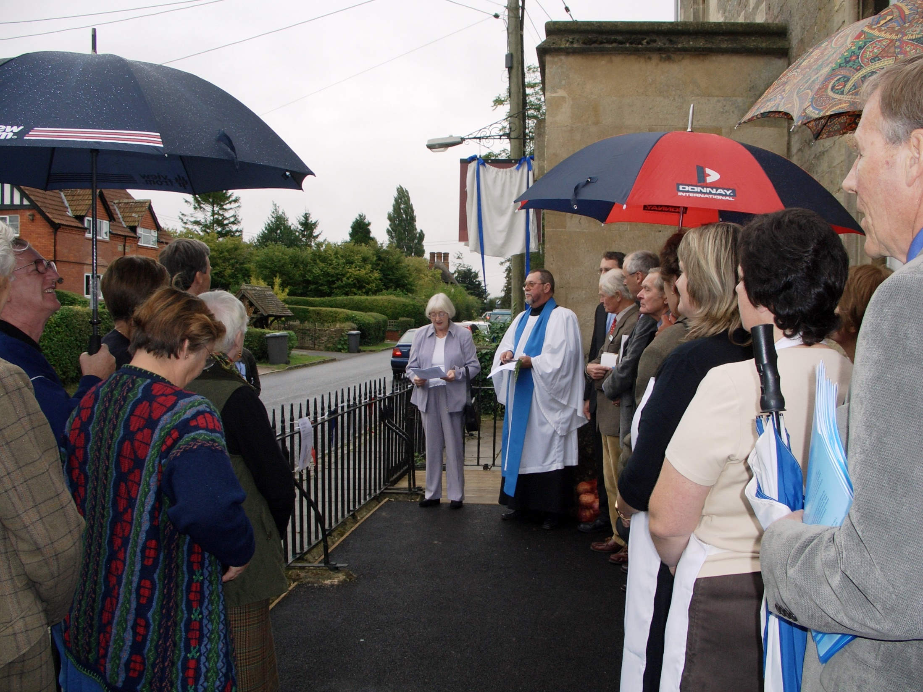
Community Shop
-
opening ceremony
-
30th September 2005

