Slide 1
Slide 1
Founded January 22nd, 2019.

Slide 2
A few glasses of wine over Christmas 2018 got Penny Hornsey chatting about the idea of restarting the Village gardening group.
She posted the suggestion on the Village Facebook site and the response was overwhelming. An informal get together in the Longs Arms followed in January 2019, and SAGE acronym was born.
General ethos:
Social, fun and educational
Organised trips out of Village
Monthly meetings
No membership required,
Low costs
A ‘floating’ Steering Group, not a committee
First meeting headline in Feb 2019…
SAGE is a newly forming group for people who like to garden, or just like gardens….

Slide 3
2019 Events – a very busy year!
Mar – ‘Meadow in my Garden’ speaker and slideshow.
Apr – Slidetalk by Gina Manning, ‘Spring/Summer’
May – coach visit to Malvern Flower Show.
June – Allotment visit meeting at Micheal Moores’ allotments.
July - Peto Gardens at Iford Manor visit.
Aug - Picnic in the Park – first one, Acreshort Community Park.
Sep - Apple orchard visit, thanks to Gerry Oughton
Oct – Slidetalk by Gina Manning, ‘Winter/Spring’
Nov - ‘Sustainable Gardening’ talk ny Penny Aberhard.
Dec - Christmas party. A pre-Christmas social evening, with a gardening theme, drinks and cold buffet and a raffle.

Slide 4
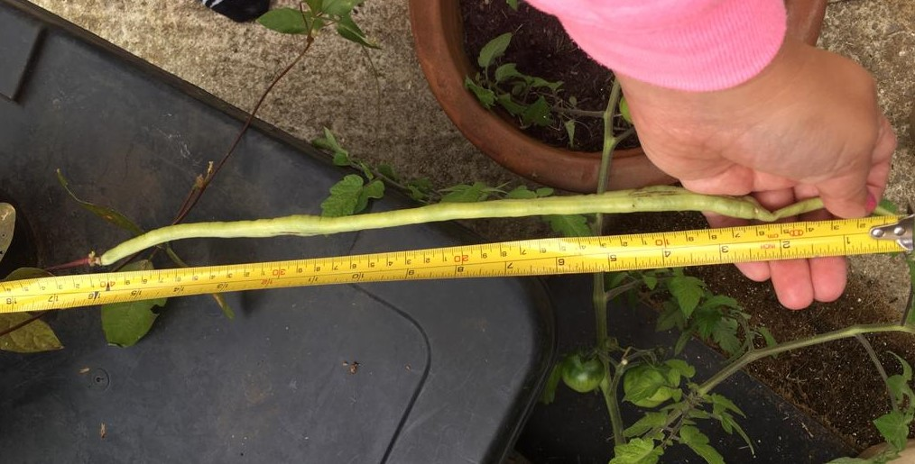
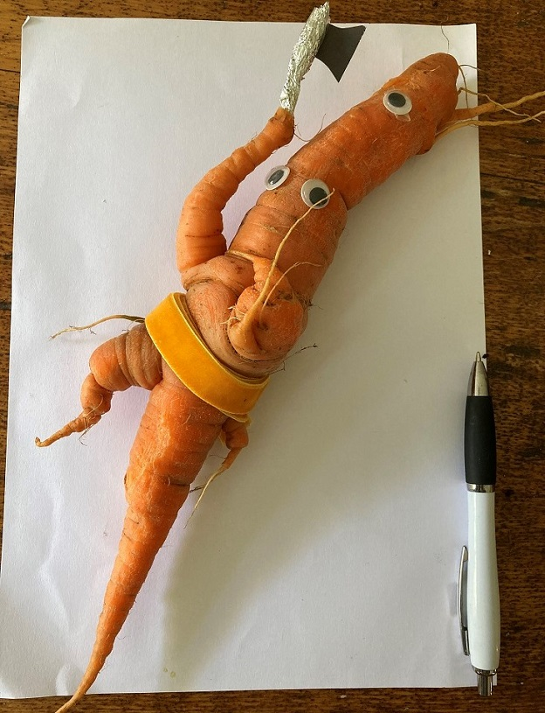
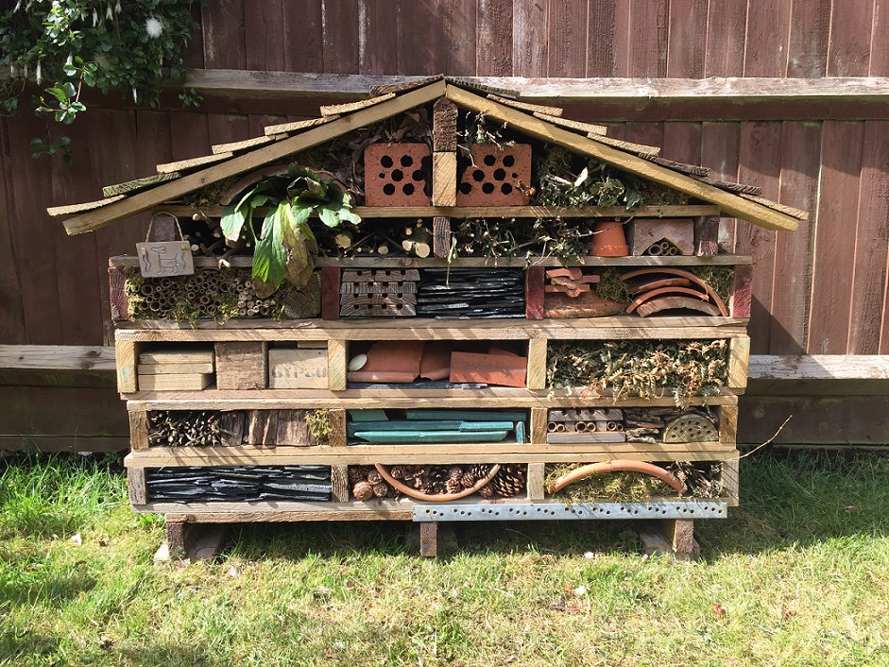
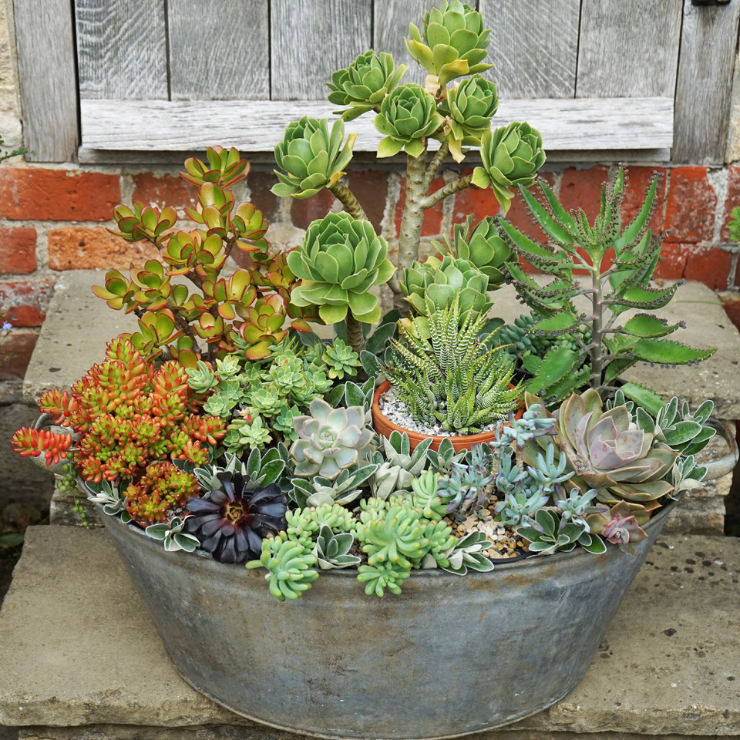
2020 Events – COVID ☹
All planned visits from March cancelled, and meetings changed to Zoom. Many online events planned…
Jan – Mendip Bonsai, demo, talk and purchase
Feb – ‘Pruning Trees & Shrubs, by Richard Cripps
May - Online Gardening Quiz
July - Village Photographic Trail competition
Sept - Digital Flower & Produce Show

Slide 5
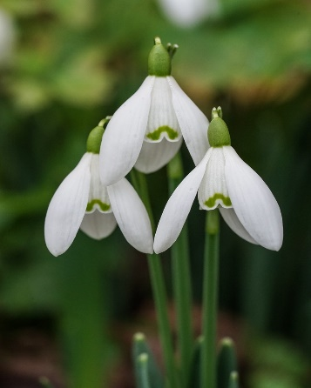
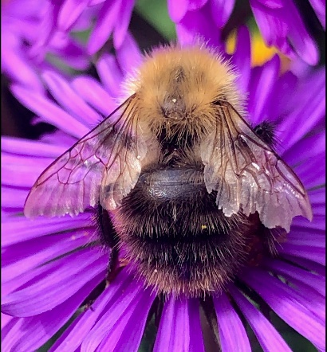
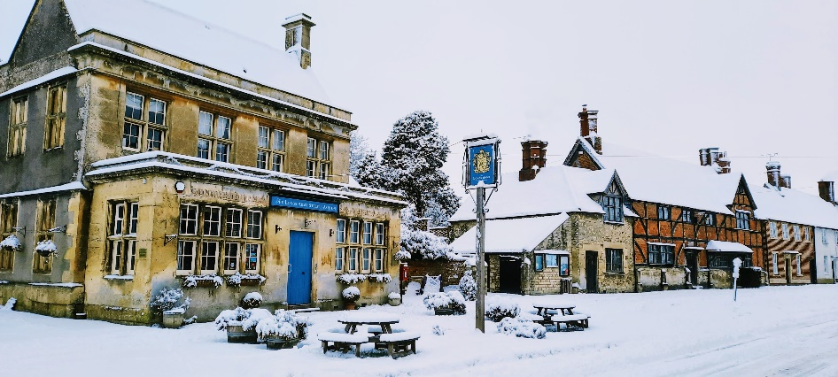
2021 Events
April – online Spring Equinox Village Photo competition, open to all – 105 entries!
Jun/Jul/Aug – ‘Village Sunflower Festival’
August – ‘Sunflower Picnic in the Park’ – we were so lucky to have squeezed this in-between lockdowns!
Dec – Digital Christmas Card competition – made from anything found in your garden.
Some of the winning entries….

Slide 6
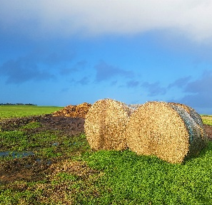
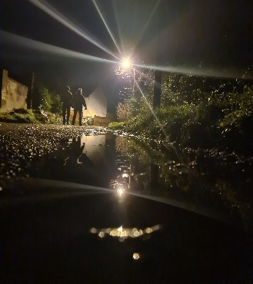
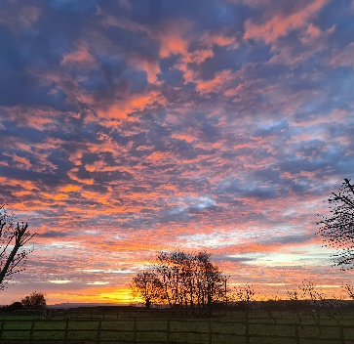
Our beautiful Village has so many talented photographers

Slide 7
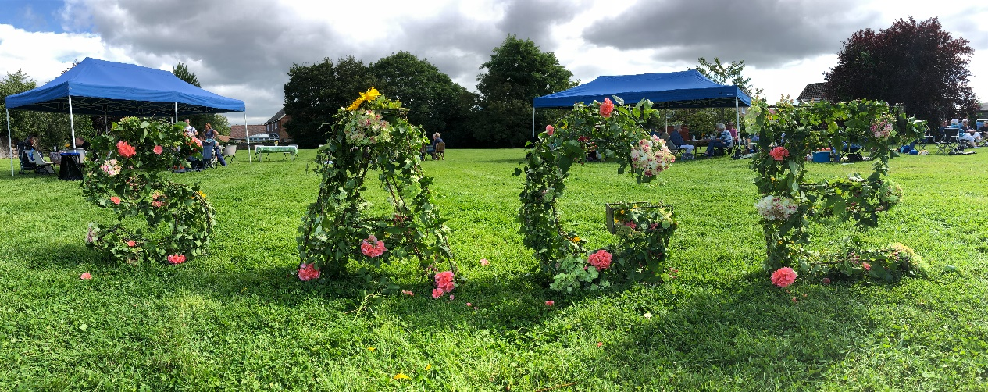
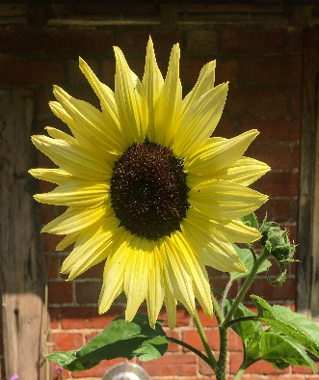
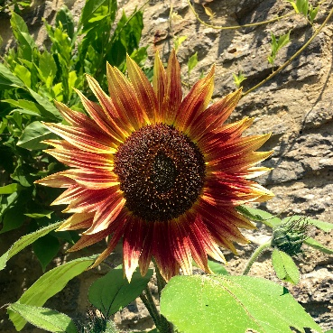
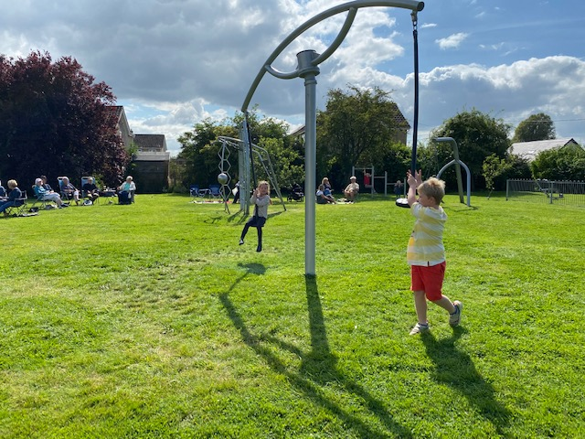
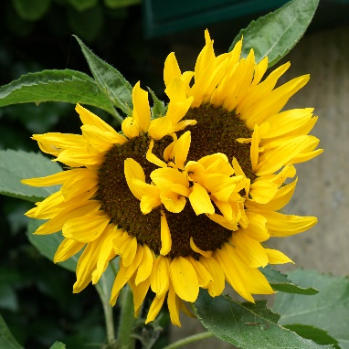
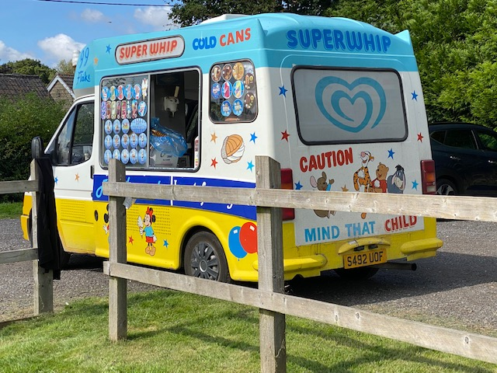
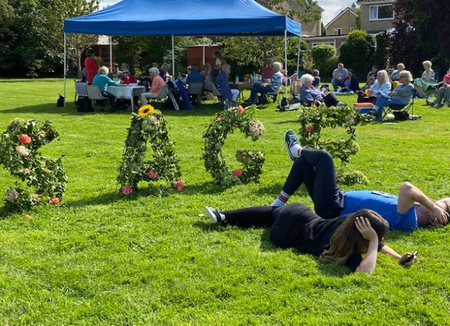
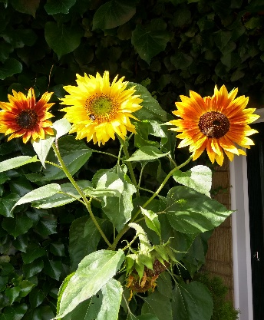
Sunflower Festival Picnic in Acreshort Community park.
August 2021

Slide 8
2022 Events
SAGE has now morphed into a Seasonal Group, with four meetings per year in the Village Hall/Acreshort Park, plus organised group visits ‘out of Village’
Spring: March 3rd - Gardeners Q&A, social, raffle, programme of events presentation and visits sign up.
Visit -April 28th – Peto Gardens at Iford Manor (fully booked)
Summer: June 9th - Speaker – Nicola Hope
Visit - July 7th – The Bishops Palace Gardens, Wells (fully booked)
Autumn: early September – tba, possibly the 3rd ‘Picnic in the Park’
Winter: early December - Christmas party – social, Quiz, refreshments, cold buffet etc. (free entry)

Slide 9
2023 Events
Spring: March 9th – Speaker: Nicola Hope – ‘Tales from the potting Shed. social, raffle, programme of events presentation and visits sign up.
Visit – March 29th - Broadleas Gardens in Devises, with tea & cake.
Visit – May 11th - The Longstock Water Garden, Stockbridge
Summer: June 9th - tba, keep an eye on noticeboards and Facebook site
Visit – June 15th – Mottisfont (Nat Trust) Gardens, Hampshire
Autumn: Sept 8th - tba, possibly the 3rd ‘Picnic in the Park’
Winter: early December - Christmas party – social, drinks, cold buffet etc..
Remember – no club to join, no membership fees, just come along, pay £2 on the door, and enjoy.
If interested in joining in on any visits please contact jennie.willis@btinternet.com
Follow us on Facebook at https://www.facebook.com/groups/2548517398732853

Slide 10
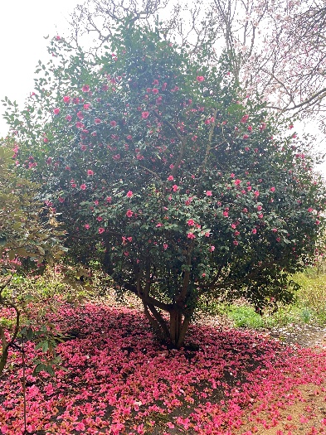
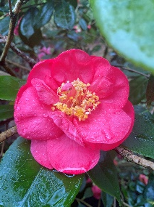
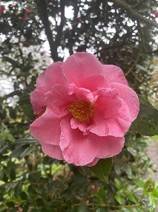
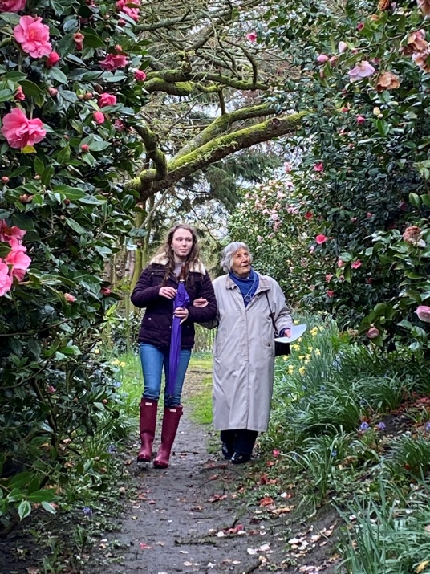
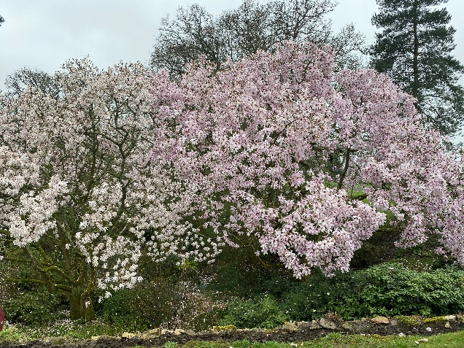
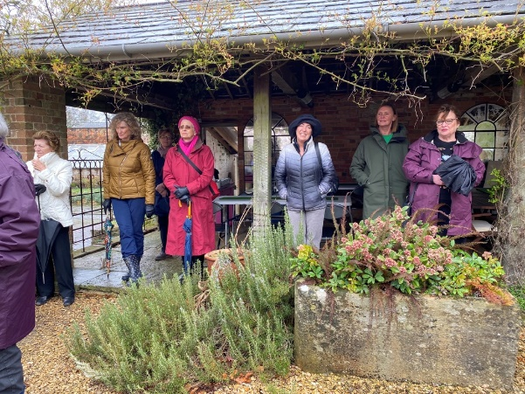
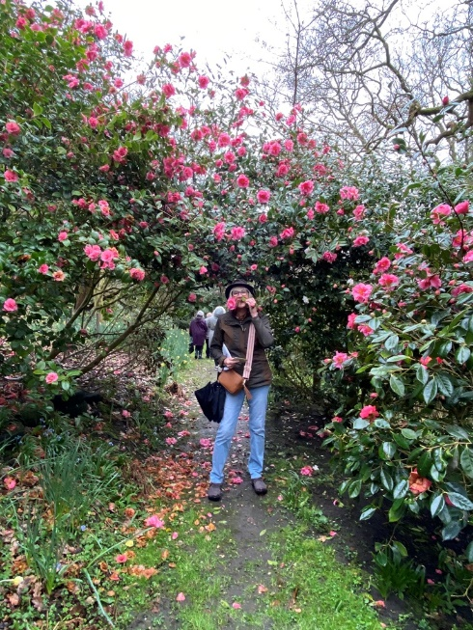
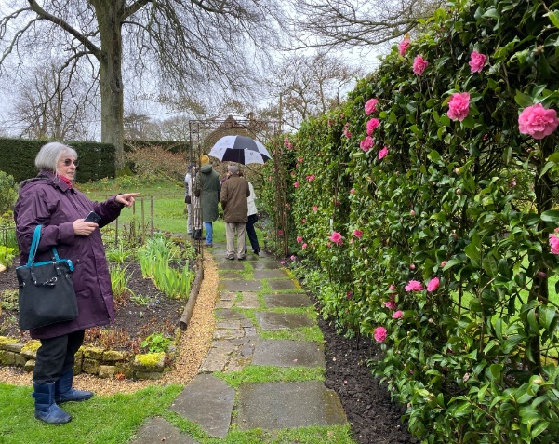
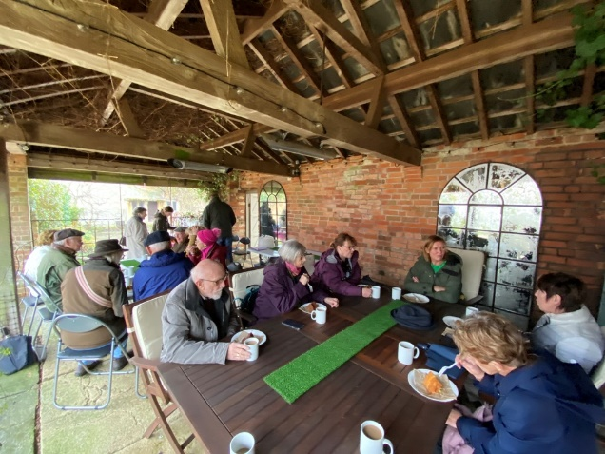
Broadleas Gardens, Devizes A riot of Magnolias and Camelias
March 29th 2023

