Slide 1
Community Report
Melksham Community Policing Team
April 2023

Slide 2
Your CPT – Melksham
The Team are keen to welcome Sergeant Gemma Rutter, who has now arrived in the Sergeants post.
She has replaced Sergeant James Twyford, who has taken up a position on the Roads Policing Unit.
Sergeant Rutter brings with her a wealth of experience over a 16 year career; having previously worked on Response, Neighbourhoods and CID as a PC, DC, Sergeant and Temporary Inspector.
Inspector:
Andy Lemon Neighbourhood Sergeant: Gemma Rutter
Neighbourhood Officers: PC Ben Coombs
PC Jennifer Miller PCSOs: Luke Hosken
Melissa Culliford
Vic Rolph

Slide 3
This Month’s Focus
Domestic Abuse Matters
Domestic Abuse has been at the forefront of the Force’s priorities list for at least the last 20 years. It’s been a subject that’s been heavily researched by academia over this time, with processes and policies constantly evolving.
We work to an extensive Approved Professional Practice manual which details the process for investigating incidents of Domestic Abuse in considerable detail, as well as the types of Safeguarding that we implement alongside our partner agencies. These investigations are scrutinised heavily at local and a force-wide level, to ensure they are quality focussed and acting in the best interests of Victims (and Perpetrators).
In addition to this; the Force has recently invested in some enhanced refresher training, which is designed to refocus Officers’ minds on the first hand effects of this type of offending upon affected households. It has also helped to bring newer offences into the spotlight, such as “Controlling and Coercive Behaviour” and “Stalking”, for which there is limited case law so far.

Slide 4
Crime Exceptions
Crime Exceptions are described as a volume of offences, outside of the normal range expected; based on the last two years worth of data.
Melksham Town
4x Possession of Weapon offences were recorded last month within the Town area, relating to three incidents. All were Charged; half were as a result of proactive work by Officers.
41x Theft Offences were recorded, which is a High by exception. 27 relate to Shoplifting; 2 were Bicycle Thefts. The top four Suspects were responsible for 18 offences (43%).
Melksham Rural North
Atworth, Broughton Gifford, Shaw, Whitley, Beanacre, Berryfield and Bowerhill
11x Theft offences were recorded across this area last month. 4 relate to Shoplifting and 7 were Bicycle Thefts. All of the bicycle thefts related to insecure bikes left unattended.
Melksham Rural South
Semington, Seend, Seend Cleeve, Great Hinton, Keevil, Bulkington, Steeple Ashton and Poulshot
Nothing outside of normal levels for this area this month.
Notes:
KGV Skate park survey

Slide 5
Local Priorities & Updates
Priority | Update
Violence Against Women and Girls | As part of wider national focus on this area, we’ve been investing in refresher training for our staff, within the Domestic Abuse context and a PCC-Led initiative called “Safer Nights” designed at making the night-time economy especially safe for women and girls.
ASB – Vines Court | In the same way as we tackled the issue in Williams Close, we are now focussing on a similar problem in Vines Court. We’re working closely with the Housing Association and Town Council to use some new and innovative CCTV technology, to help detect offences which are occurring within the road.

Slide 6
Useful Links
For more information on Wiltshire Police’s performance please visit:
PCC’s Website - https://www.wiltshire-pcc.gov.uk/
HMICFRS Website - https://www.justiceinspectorates.gov.uk/hmicfrs/police-forces/wiltshire/
For information on what crimes and incidents have been reported in the Trowbridge Community Policing Team area, which Melksham is part of, visit https://www.police.uk/pu/your-area/wiltshire-police/

Slide 7
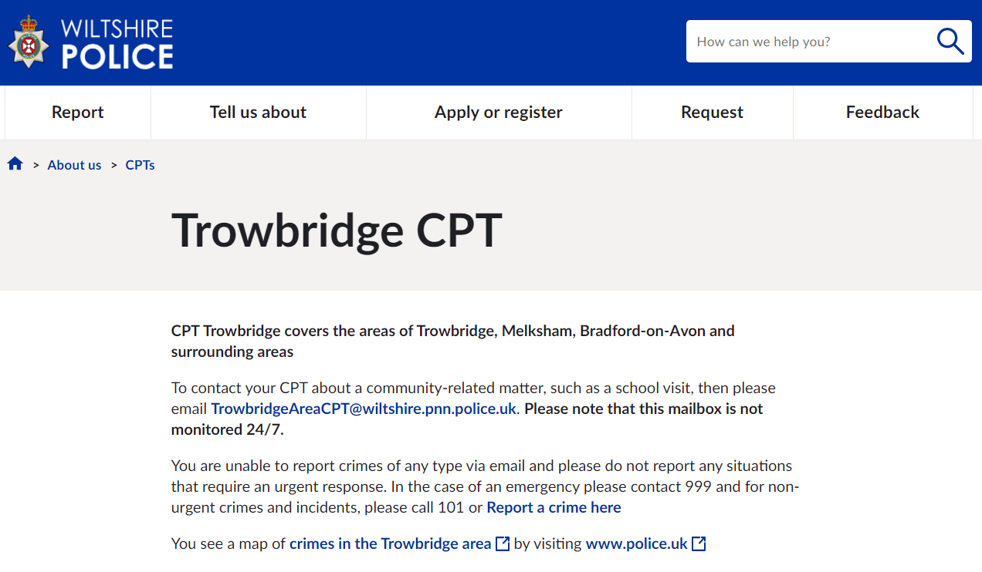
Get Involved
Keep up to date with the latest news and alerts in your area by signing up to our Community Messaging service – www.wiltsmessaging.co.uk
Follow your CPT on social media
Trowbridge Police Facebook
Trowbridge Police Twitter
Melksham Police Facebook
Bradford on Avon Facebook
Find out more information on your CPT area at: www.wiltshire.police.uk and here www.wiltshire-pcc.gov.uk

