Slide 1
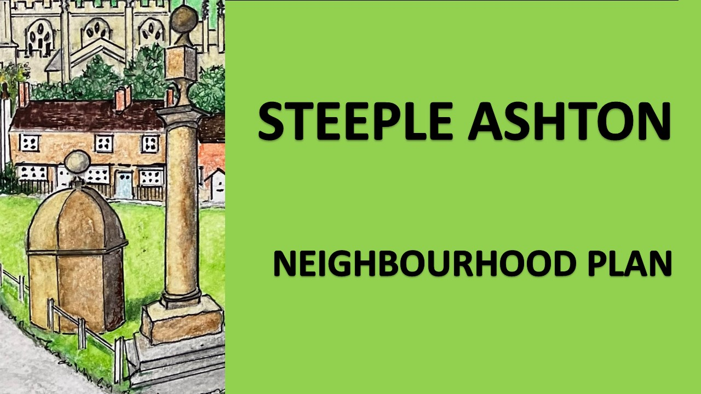

Slide 2
Over 220 Questionnaires completed
A range of potential housing sites put forward
Steering Group set up

Slide 3
Feedback from questionnaires….

Slide 4
VALUE

Slide 5
IMPROVE

Slide 6
TO
PROTECT

Slide 7
Feedback from questionnaires….
….Set up four sub groups

Slide 8










Environment & Heritage;
What is important
What should be protected
What is valued
Environmental and nature

Slide 9









Housing;
What we need
Where
Type & density

Slide 10





Infrastructure;
Utilities
Roads & Traffic
Facilities

Slide 11





Social
What makes the of the village
Activities
Community

Slide 12

What will this achieve?

Slide 13

Scope for Neighbourhood Plan
Areas Parish Council see as normal business
Good ideas to be implemented outside of plan – by villagers, if they want them
Areas outside of Parish responsibility

Slide 14
Housing Site Assessment
Over 20 sites
Need to be assessed by a standard
Criteria
May get rejected for various reasons
Externally assessed - impartiality

Slide 15

And then……
We review
We recommend
We consult………with you

Slide 16

………Make a plan
(not as simple as that……..but you get the drift)

