Slide 1
Acreshort Park Timeline 2014 onwards
Village amenity with parking
Low cost to village
Effective use of an asset
Income to cover costs

Slide 2
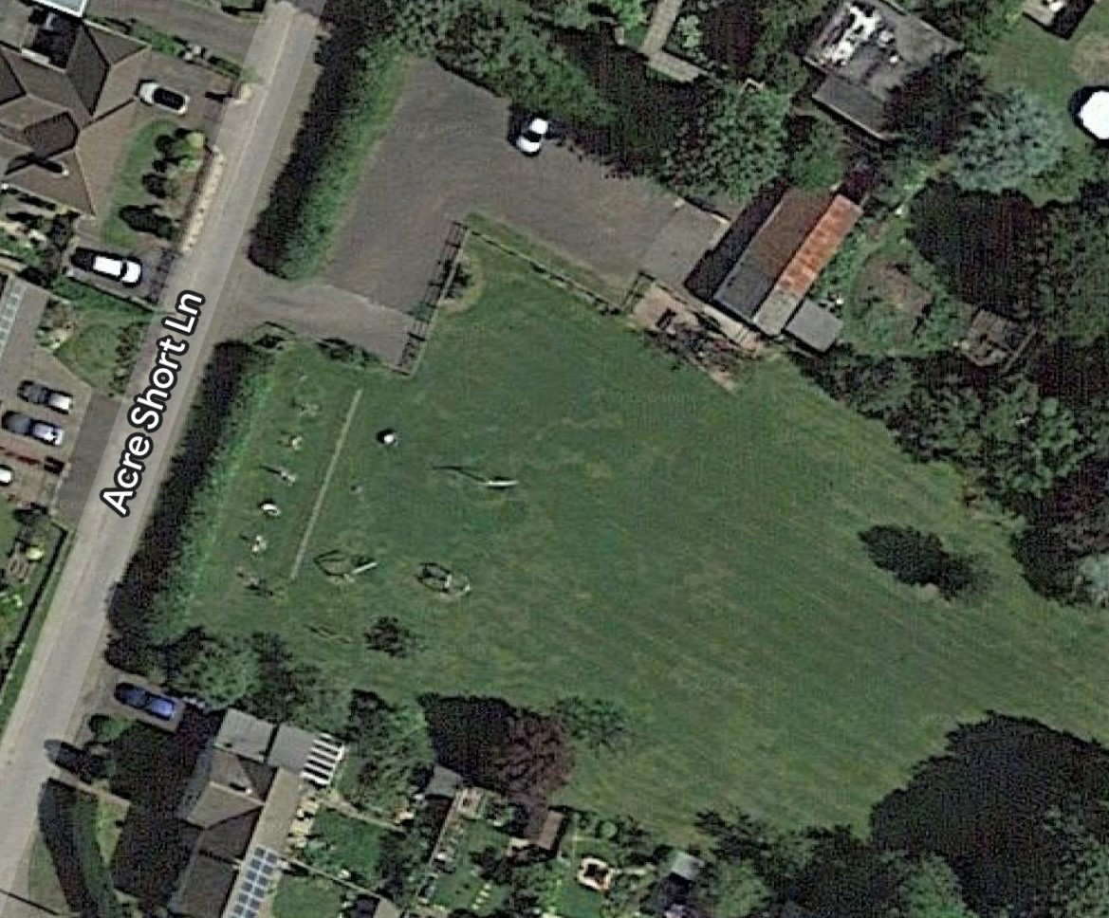
2015
WWMRC utilization
Refurbished and renovated hut
Installed toilet, sink + hot water
Storage for PC
Dry, clean and has a purpose
Financed by WWMRC and grants
Parking for field
Village event parking

Slide 3
2016
WWMRC full utilisation
1st stage planting
8 x shrubs
Tree stump seats
500 x bulbs
Parking for events in field
Guides using facilities
Parking area improved
BIG THANK YOU
Dave Propert & Sons for work on the parking area
And Geoff Hyatt for generous donation

Slide 4
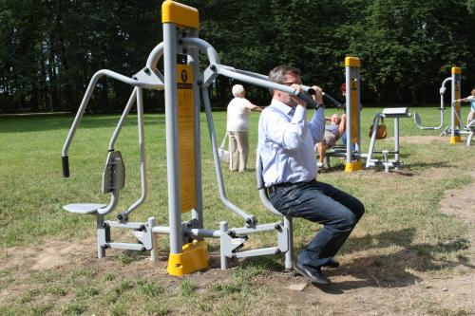
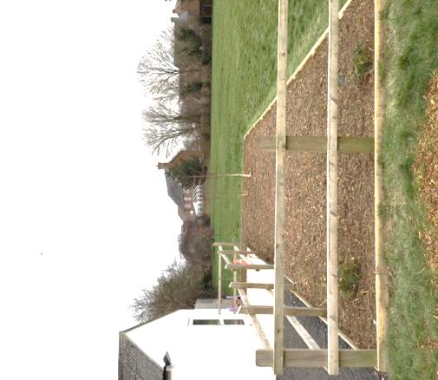
2017
Play and adult fitness equipment – obtaining quotes
Planting
Planted Mary Barnett Tree
Entrance Improvements
Picnic area

Slide 5
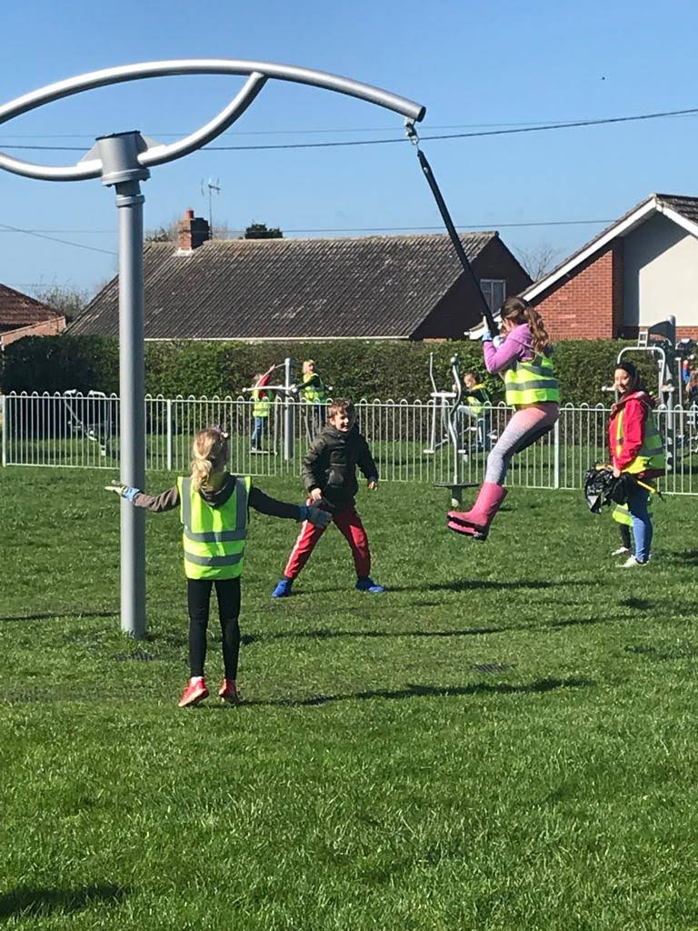
2018
Installed play equipment & outside gym
Thank you…….
Recreation Group
Melksham Area Board
Sponsors
Project Team
Exercise equipment for all ages

Slide 6
The Launch event

Slide 7
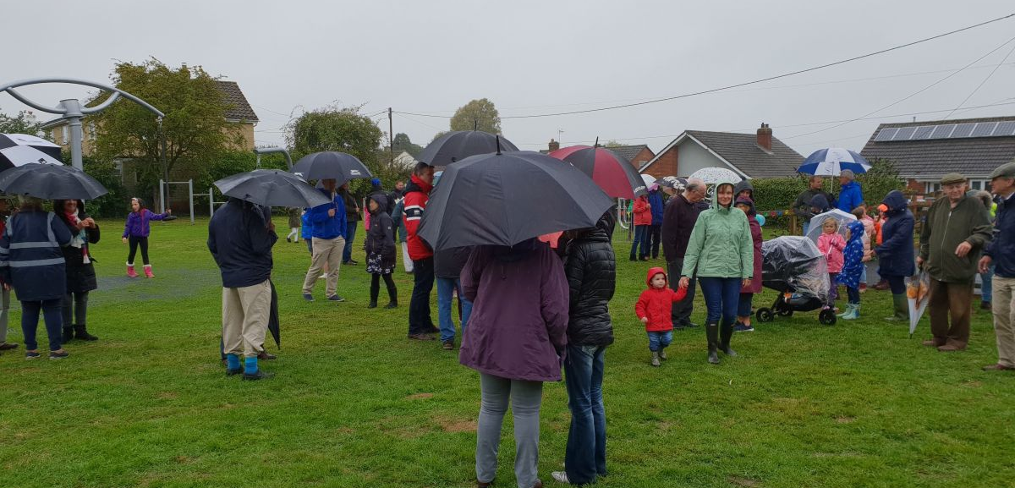

Slide 8
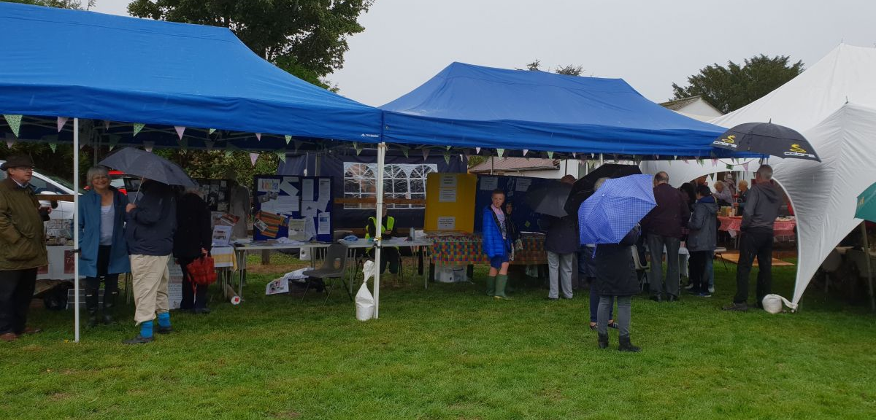

Slide 9
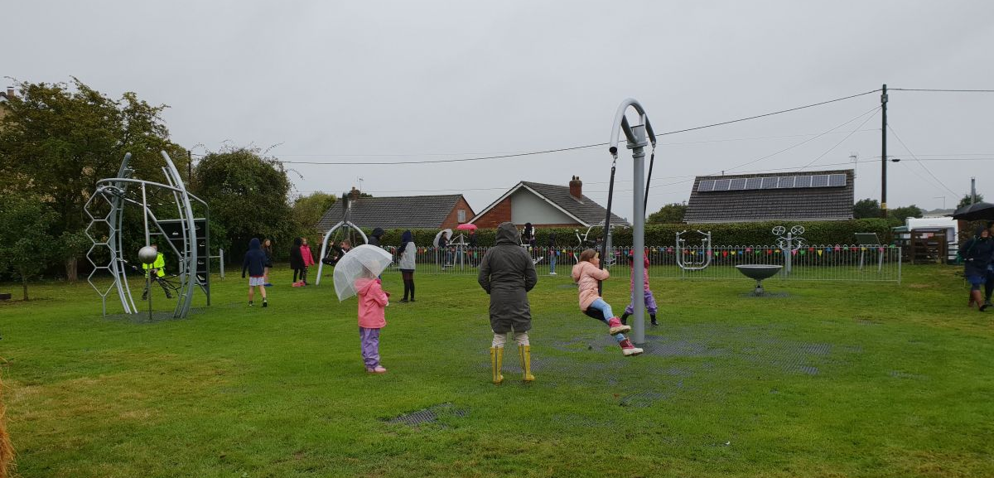

Slide 10
Marina Wyborn Cutting the Ribbon….

Slide 11
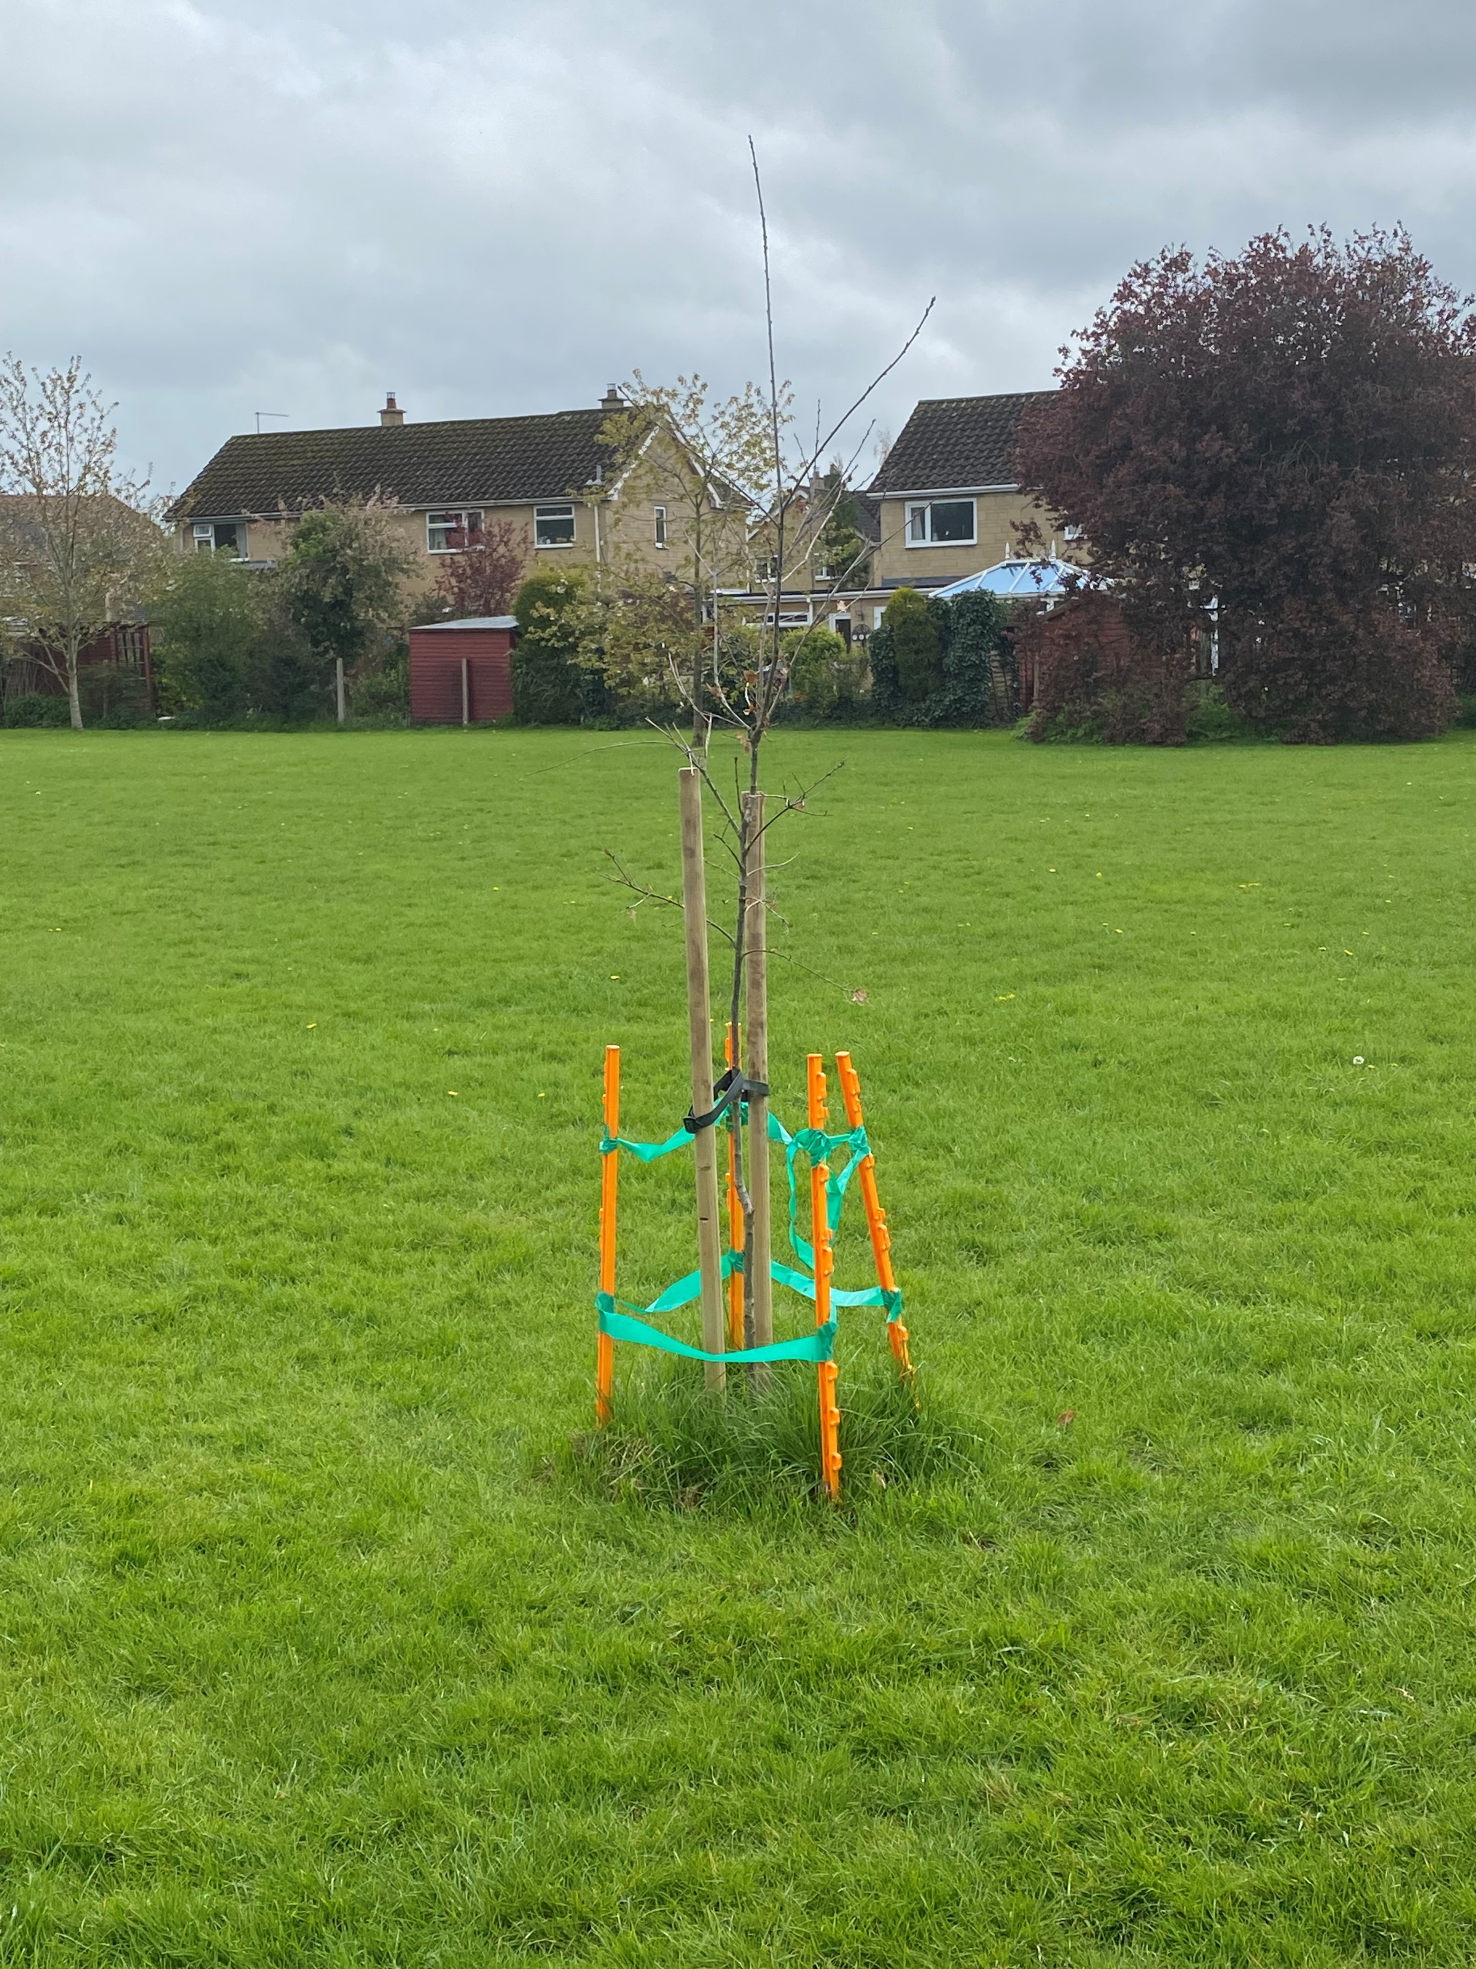
2018 - 2022
Planting – mainly from donations
Guides camping
Tree pruning and border upkeep
Notice board designed, ordered an erected
– including named sponsors sign, and upcoming events
and BIG thanks to Richie Boardman (an FOTP*) and Dave Price (on Committee)
for all their hard work ordering and the installation.
Planting of a commemorative English Oak sapling
in memory of Queen Elizabeth II

Slide 12
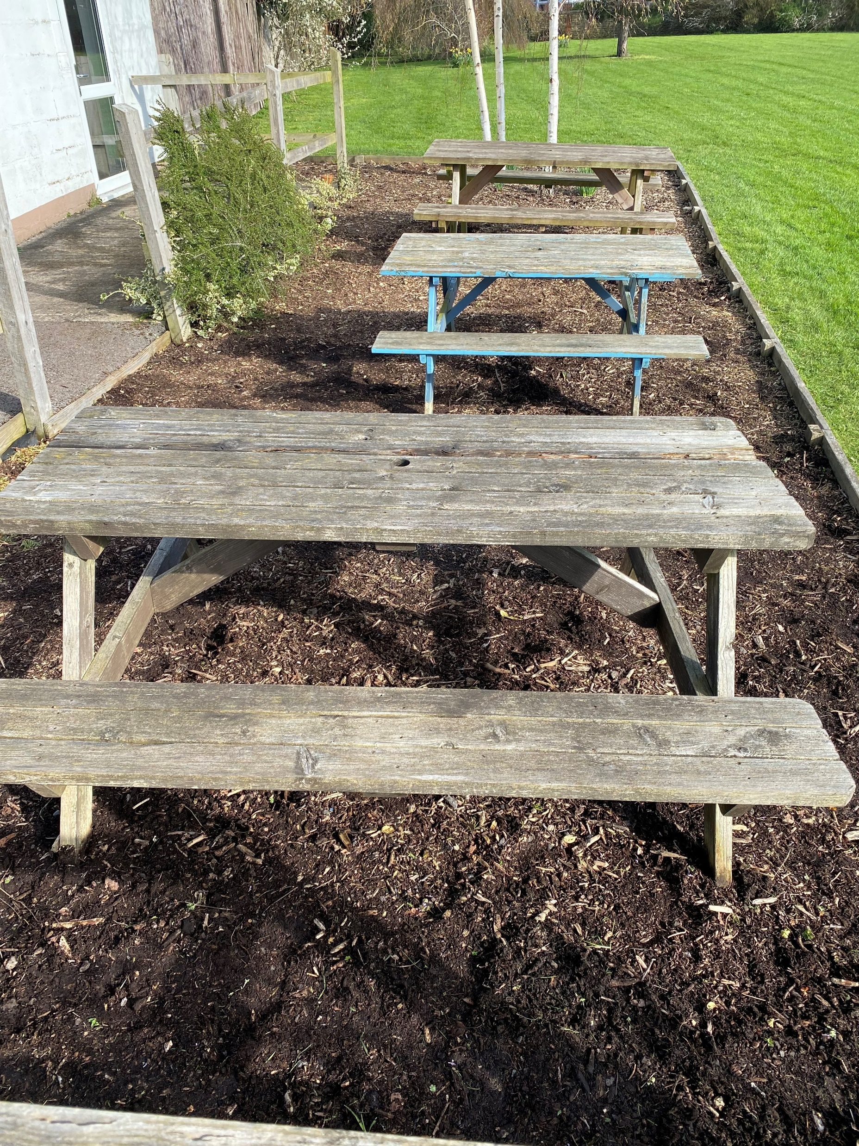
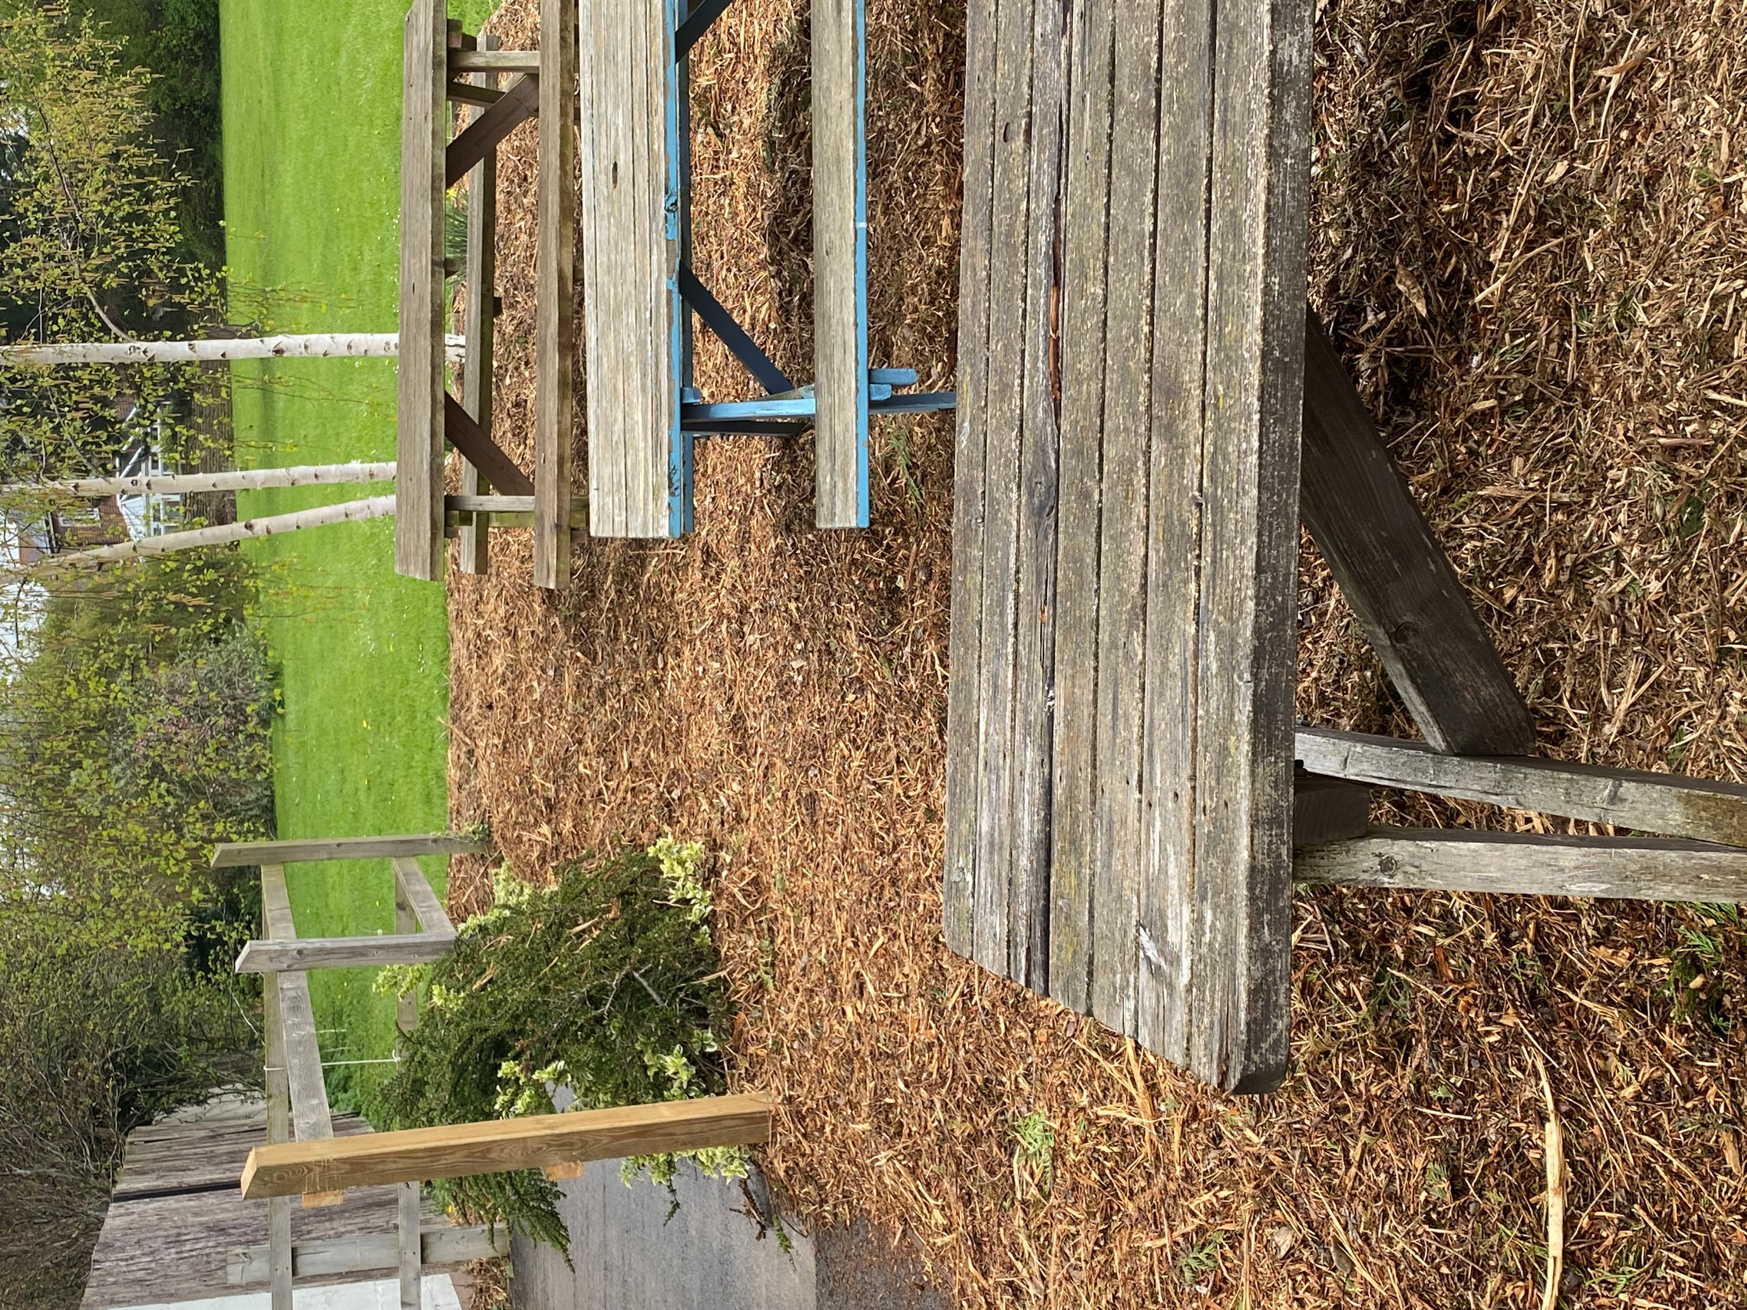
2023 onwards………
Maintenance annual – trees, weeds, hedges
Rotting fence post replaced and donated woodchip spread onto picnic area to refresh
– many thanks to Dean Collis – an FOTP*
Refurbishment of wooden picnic tables x 3 (light sand & re-stain) to be done
Ongoing repairs and maintenance to the hut & kitchen/bathroom
Introduction of Park benches – perhaps sponsored….?
Rental contract for hut kitchen & bathroom for village events/children's parties etc.
FOTP – Friends of the Park, more needed…
Current Committee: Mel Burge, Dave Price, Paula Boardman,
Verity Yates. New Committee members needed….
If you would like to get involved with the Park, or for any more info please
contact Mel on melanieburge99@gmail.com
Or find me on Messenger, or Steeple Ashton Village facebook site.

